Slide 1
2026 aYce Guide
WHAT DO YOU WANT TO BECOME?

Slide 2
The
Careers
3

Slide 3
Which careers does your Child like the most?
1.
2.
3.

Slide 4
Career 1 (name):
Why does your child like this career?

Slide 5
Career 2 (name):
Why does your child like this career?

Slide 6
Career 3 (name):
Why does your child like this career?

Slide 7


Slide 8
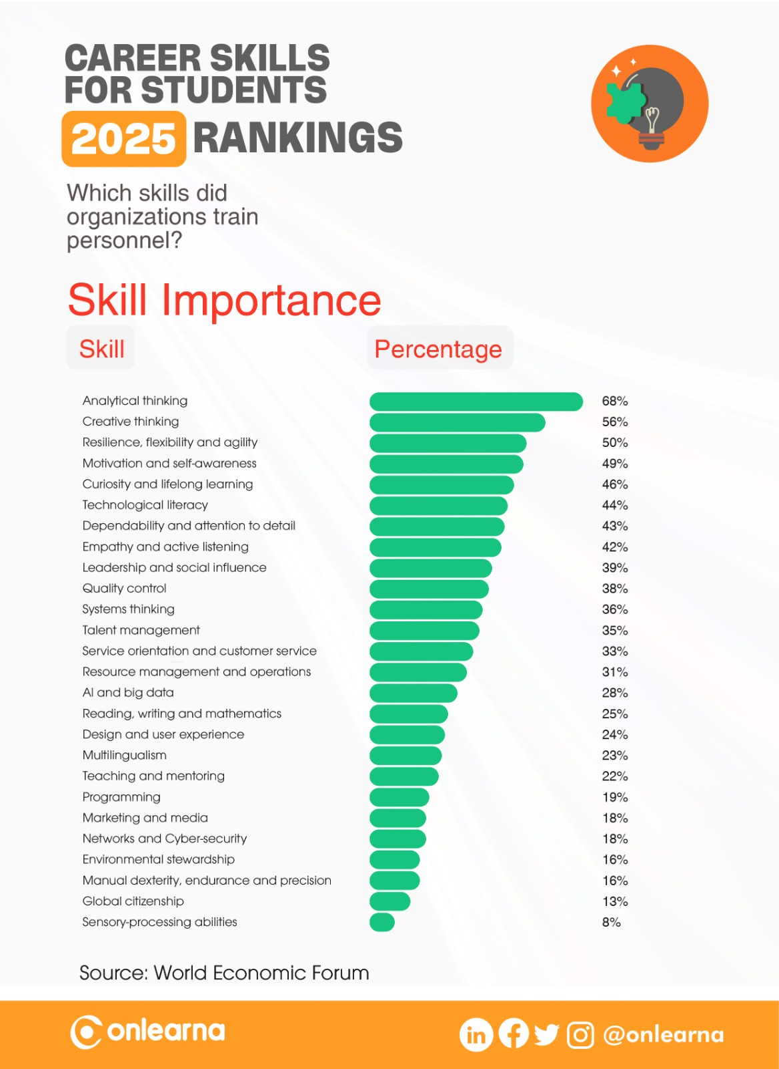

Slide 9
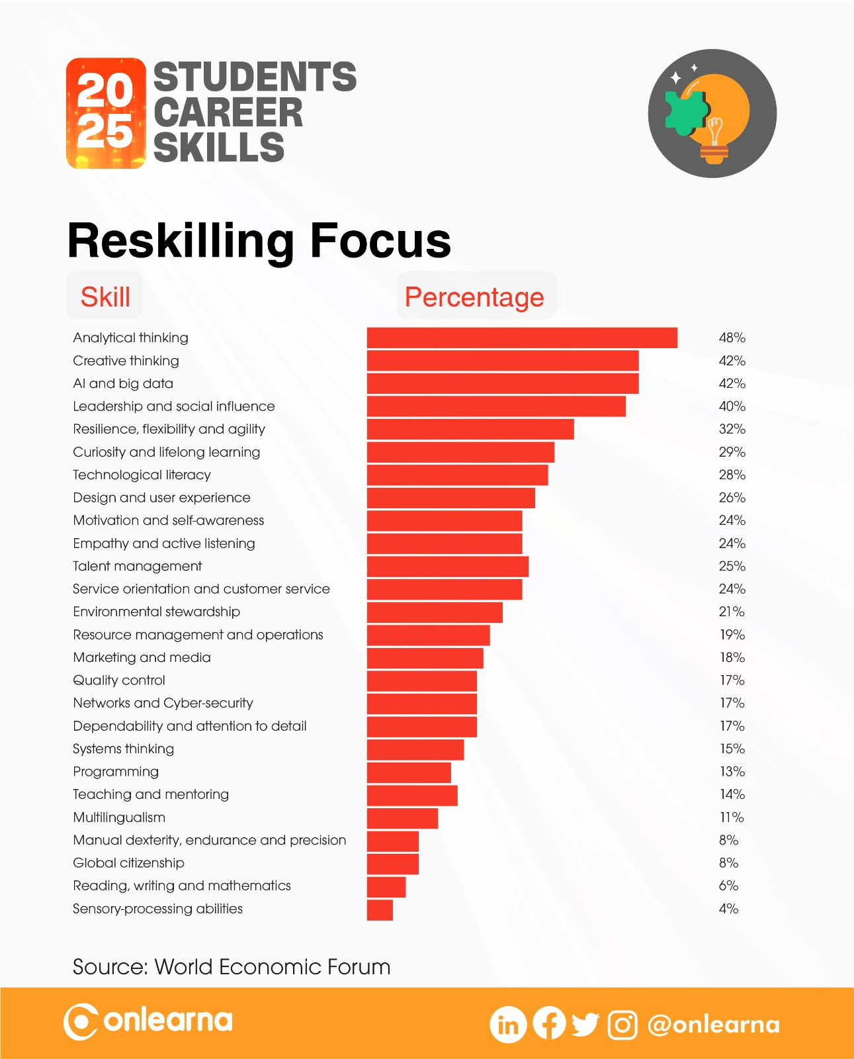

Slide 10
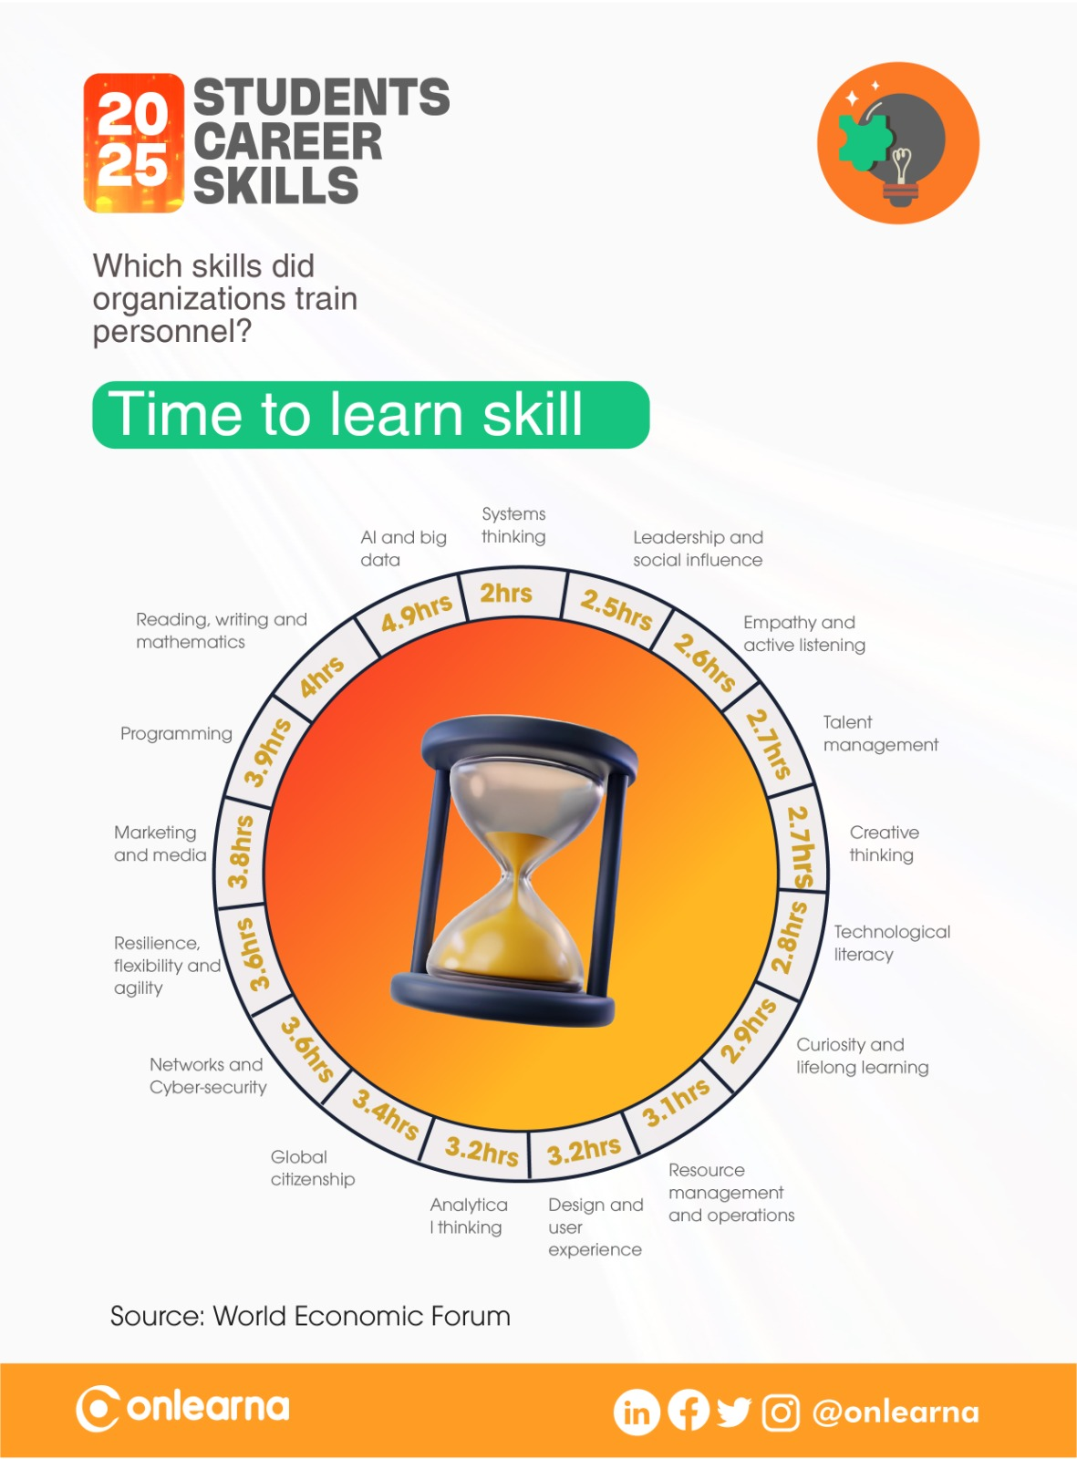

Slide 11
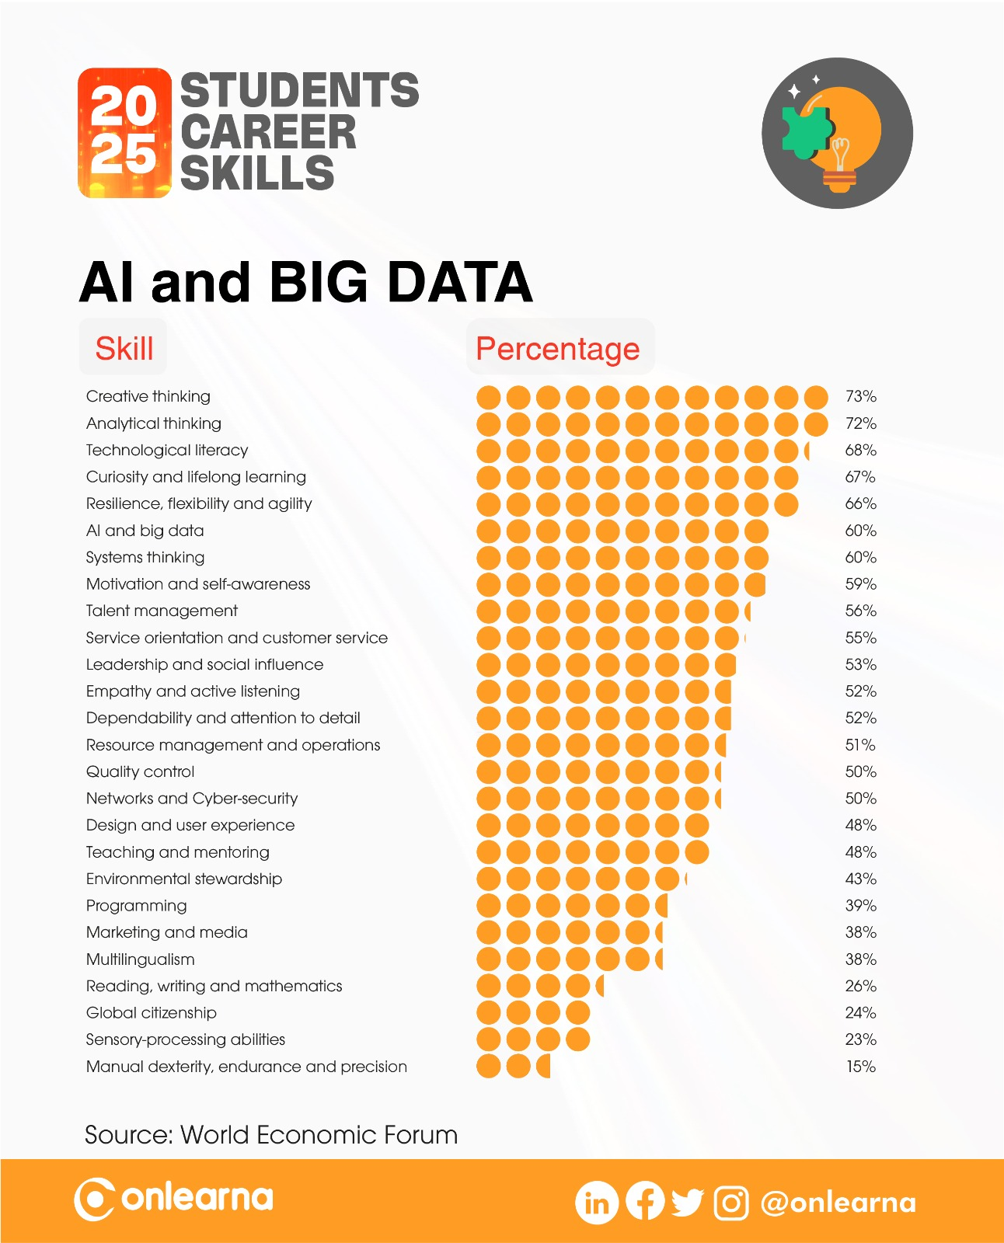

Slide 12
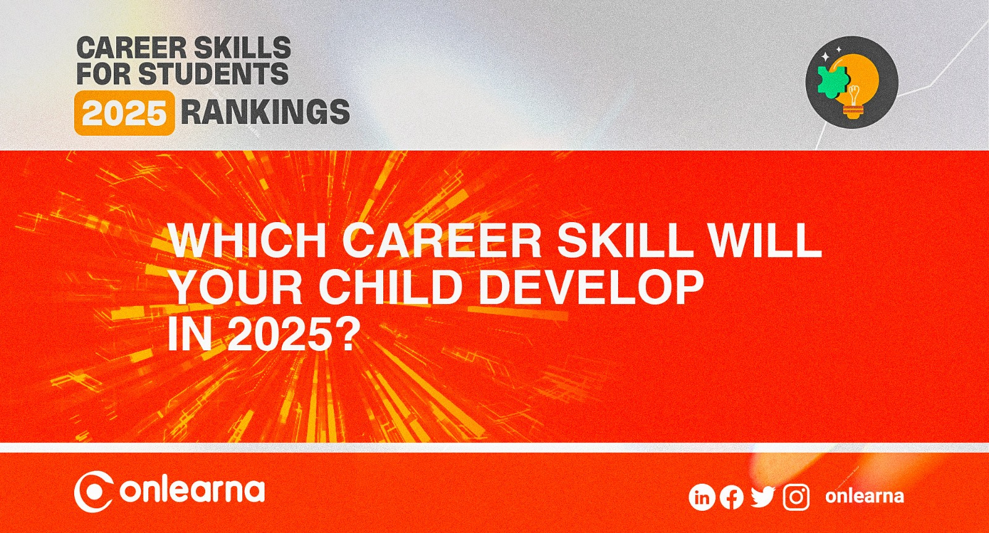

Slide 13
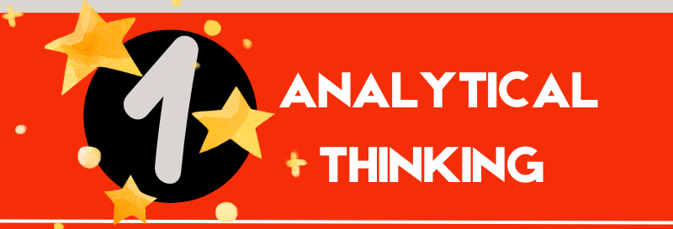

Slide 14
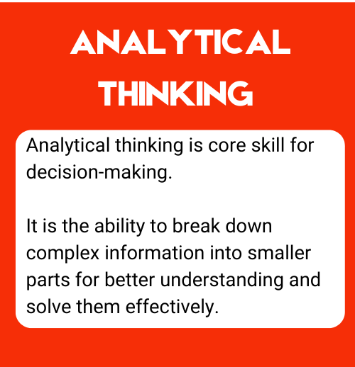
What is Analytical Thinking skill?

Slide 15
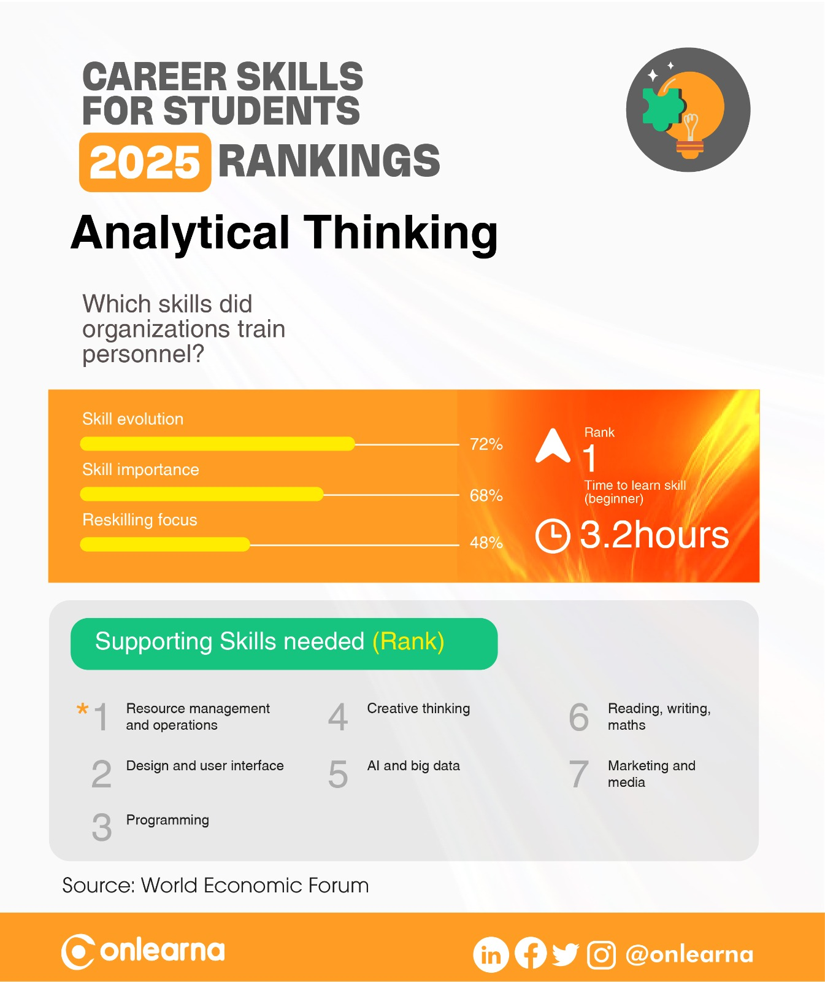

Slide 16
ANALYTICAL THINKING
What does your child like about this career skill?
What your child doesn’t like about this career skill?

Slide 17
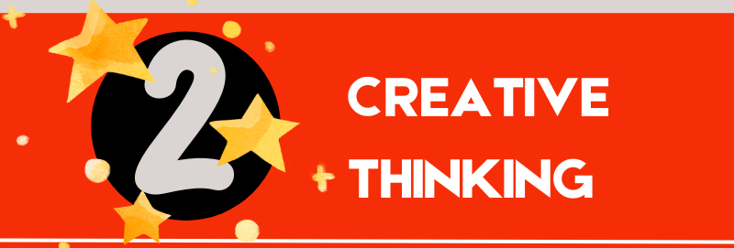

Slide 18
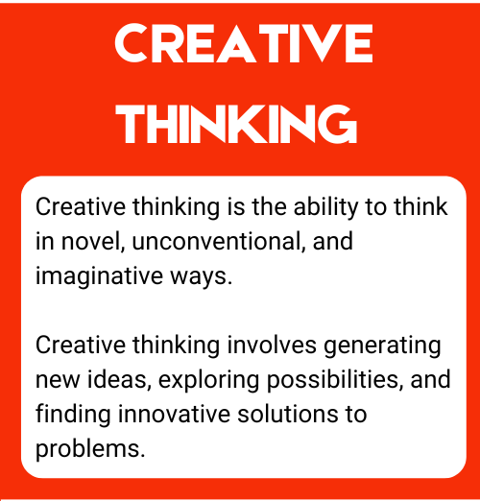
What is Creative Thinking skill?

Slide 19
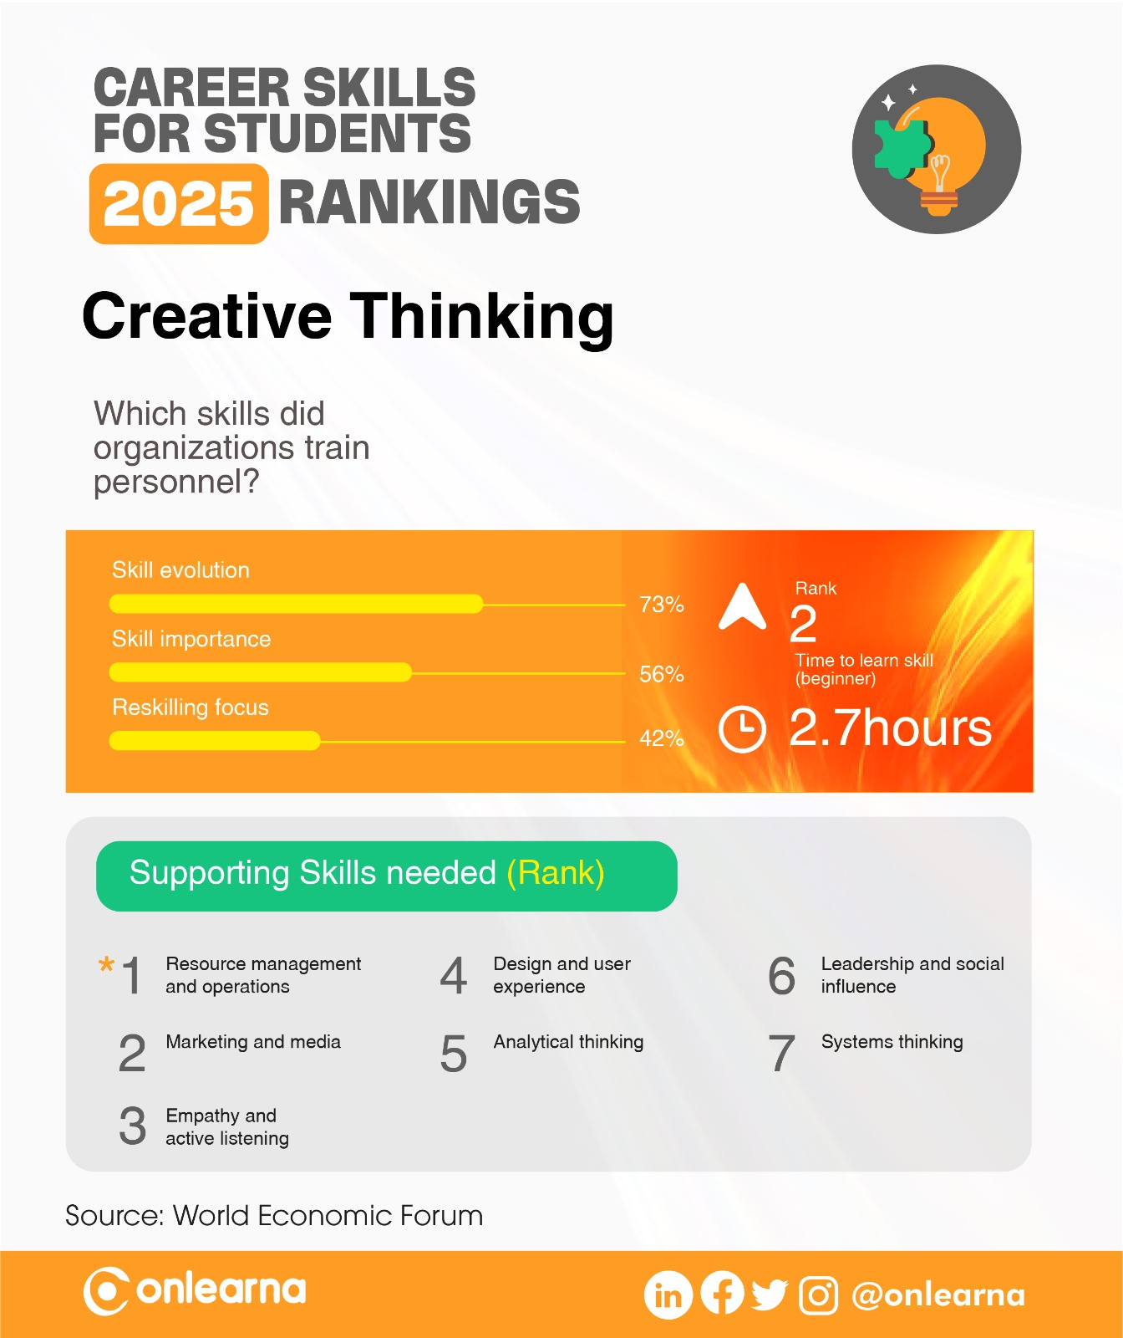

Slide 20
CREATIVE THINKING
What does your child like about this career skill?
What your child doesn’t like about this career skill?

Slide 21
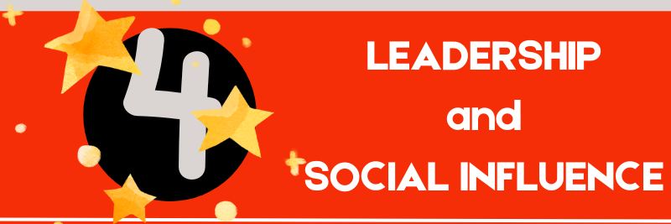

Slide 22
What is Leadership & Social Influence skill?

Slide 23
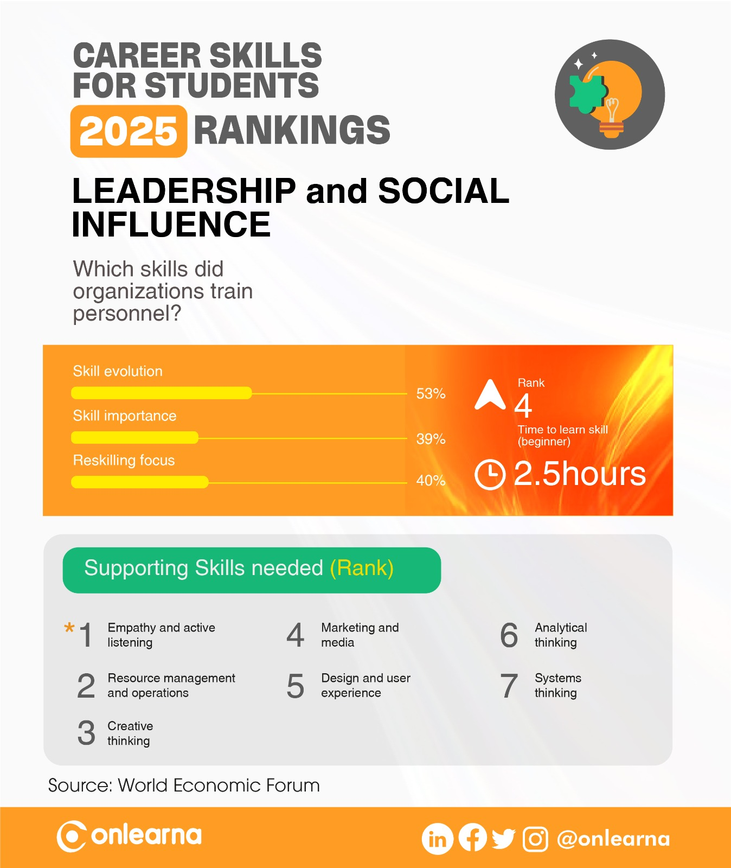

Slide 24
LEADERSHIP & SOCIAL INFLUENCE
What does your child like about this career skill?
What your child doesn’t like about this career skill?

Slide 25


Slide 26
What is Resilience, Flexibility and Agility?

Slide 27


Slide 28
RESILIENCE, FLEXIBILITY & AGILITY
What does your child like about this career skill?
What your child doesn’t like about this career skill?

Slide 29


Slide 30
What is Curiosity & Lifelong Learning skill?

Slide 31


Slide 32
CURIOSITY and LIFELONG LEARNING
What does your child like about this career skill?
What your child doesn’t like about this career skill?

Slide 33


Slide 34
What is Tech Literacy skill?

Slide 35
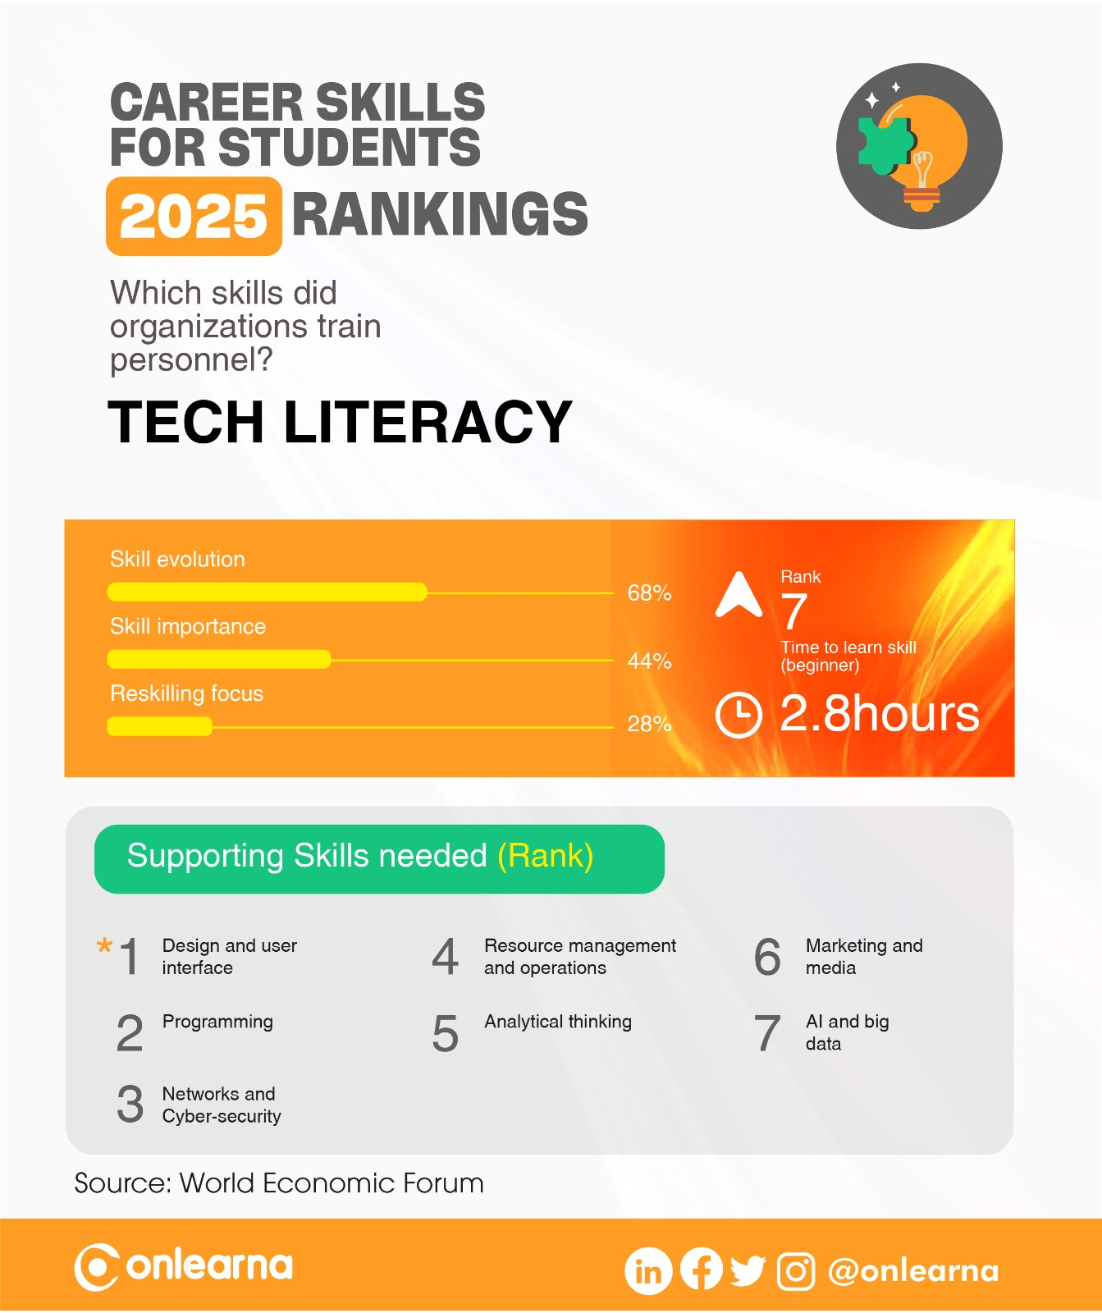

Slide 36
TECH LITERACY
What does your child like about this career skill?
What your child doesn’t like about this career skill?

Slide 37
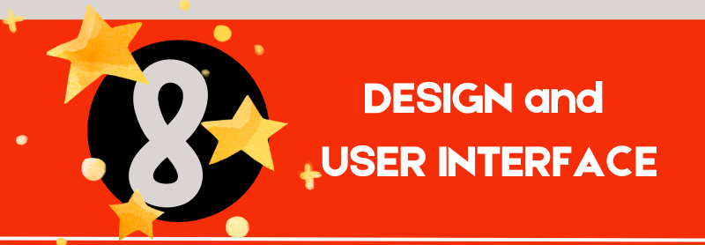

Slide 38
What is Design & User Literacy skill?

Slide 39
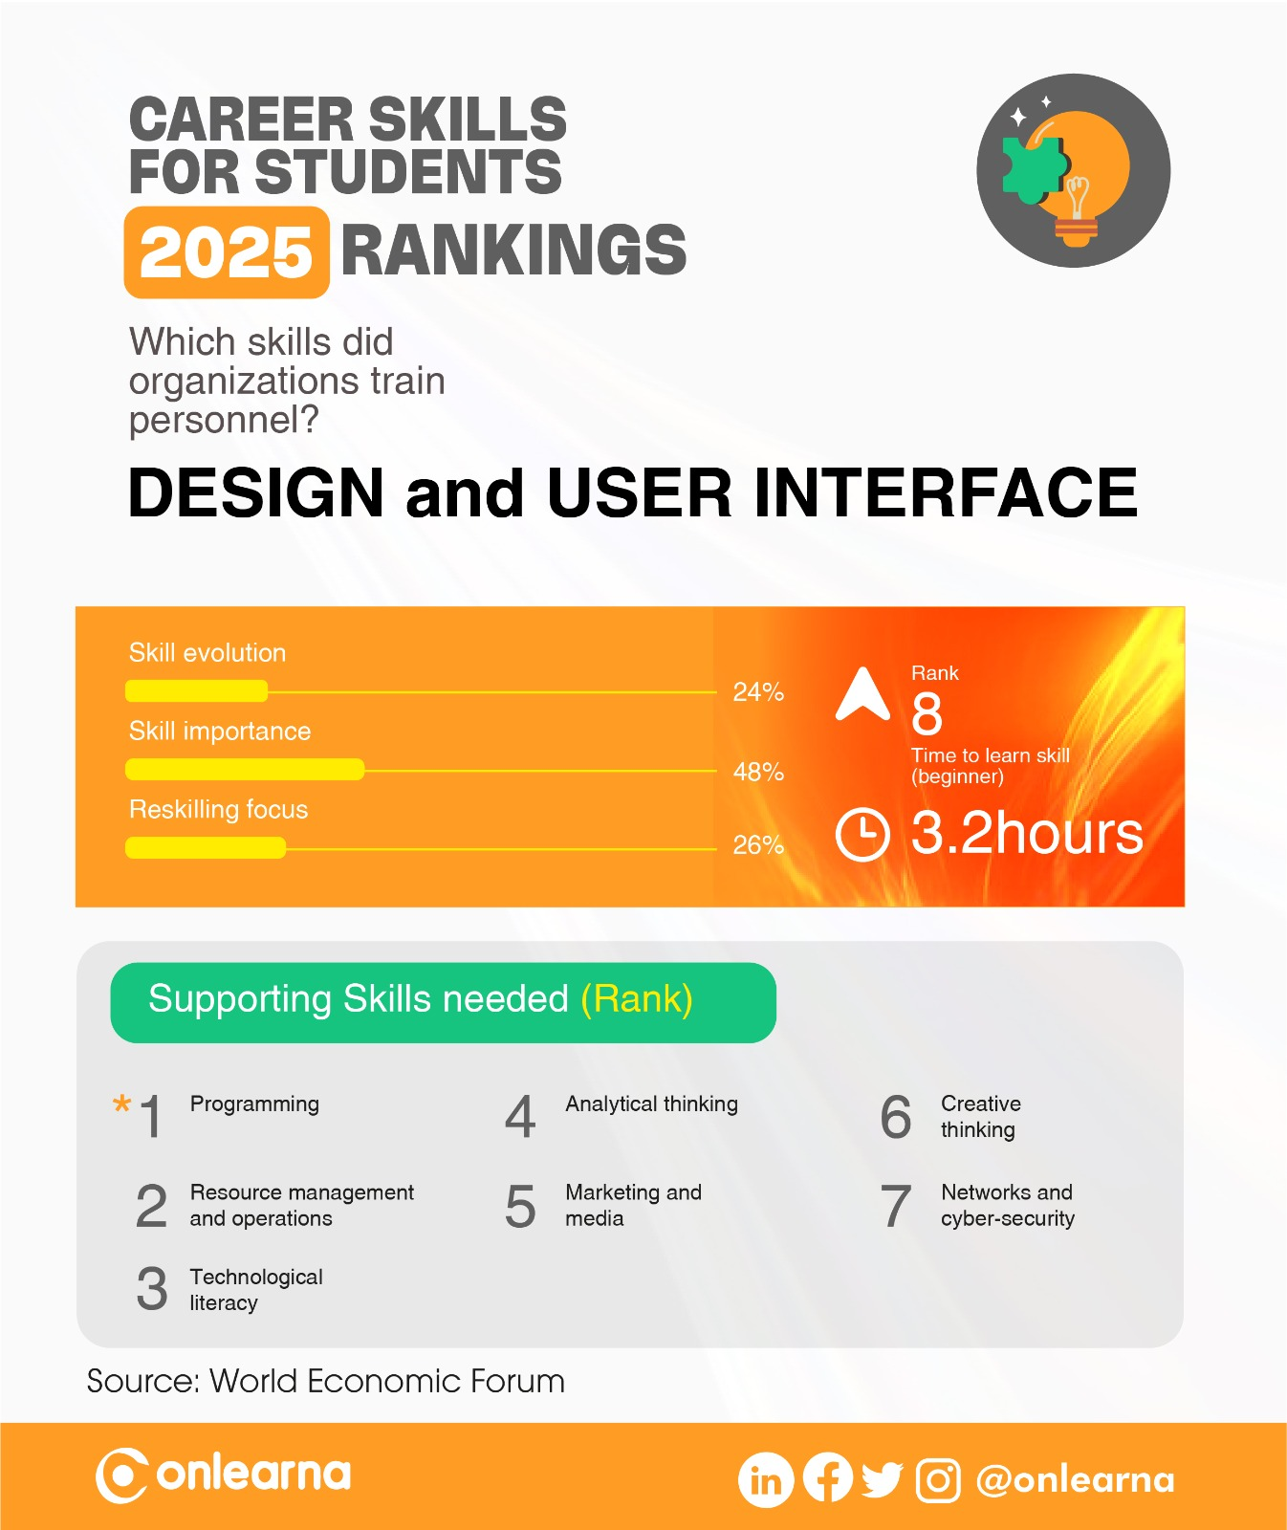

Slide 40
DESIGN & USER INTERFACE
What does your child like about this career skill?
What your child doesn’t like about this career skill?

Slide 41
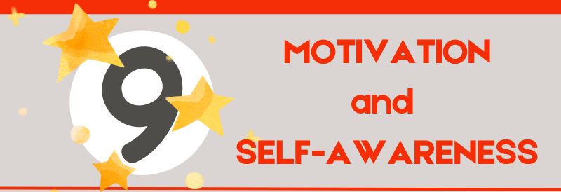

Slide 42
What is Motivation and Self-awareness?

Slide 43
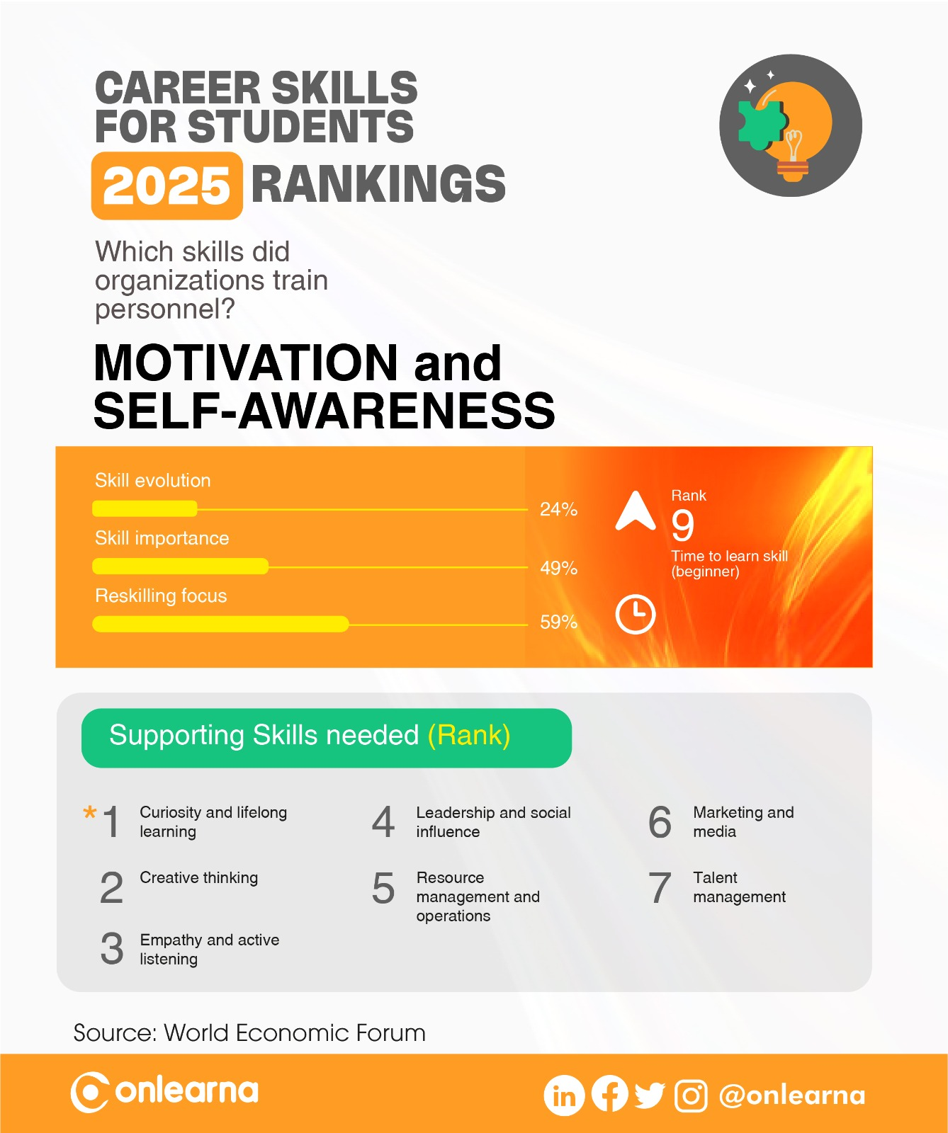

Slide 44
MOTIVATION & SELF-AWARENESS
What does your child like about this career skill?
What your child doesn’t like about this career skill?

Slide 45
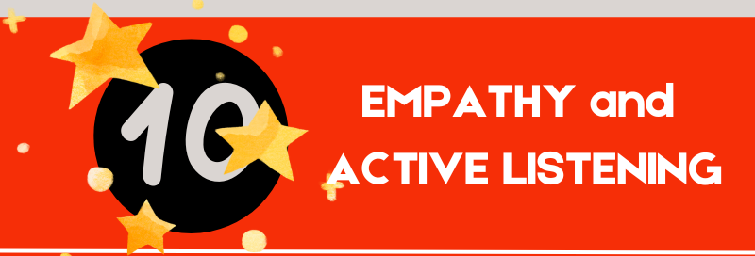

Slide 46
What is Empathy & Active Listening?

Slide 47
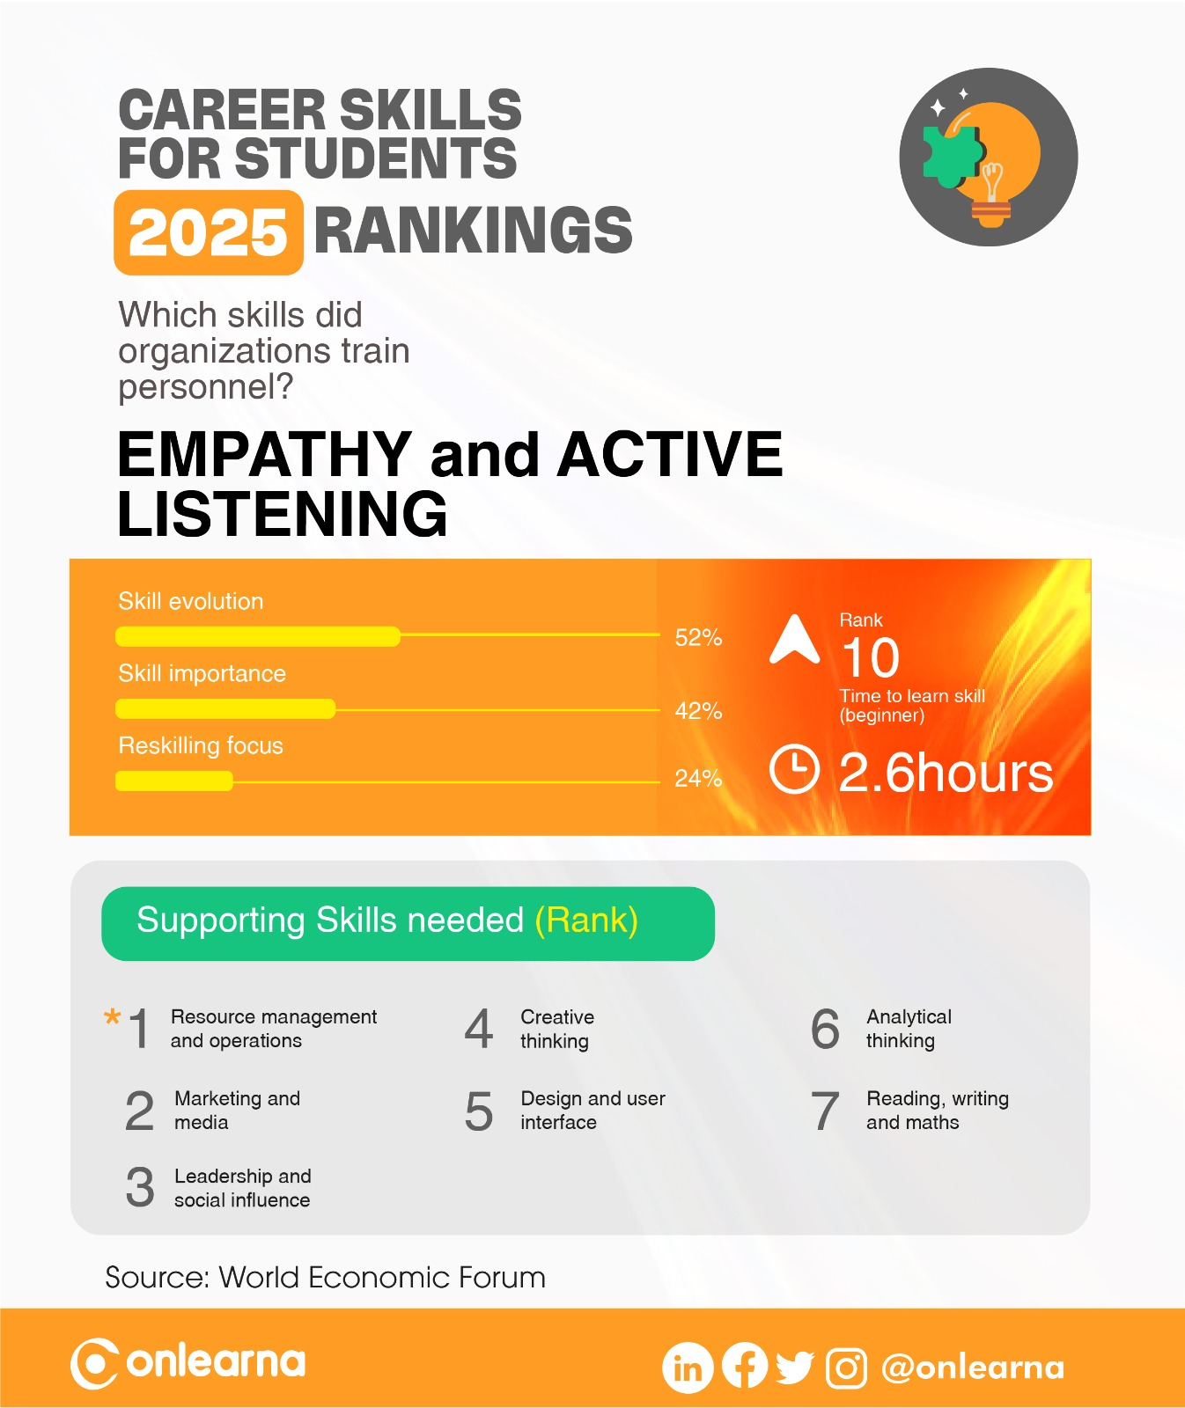

Slide 48
EMPATHY & ACTIVE LISTENING
What does your child like about this career skill?
What your child doesn’t like about this career skill?

