Slide 1
2026 aYce Guide
WHAT DO YOU WANT TO BECOME?

Slide 2
The
Careers
5

Slide 3
Which careers does your Child like the most?
1.
2.
3.
4.
5.

Slide 4
Career 1 (name):
Why does your child like this career?

Slide 5
Career 2 (name):
Why does your child like this career?

Slide 6
Career 3 (name):
Why does your child like this career?

Slide 7
Career 4 (name):
Why does your child like this career?

Slide 8
Career 5 (name):
Why does your child like this career?

Slide 9


Slide 10
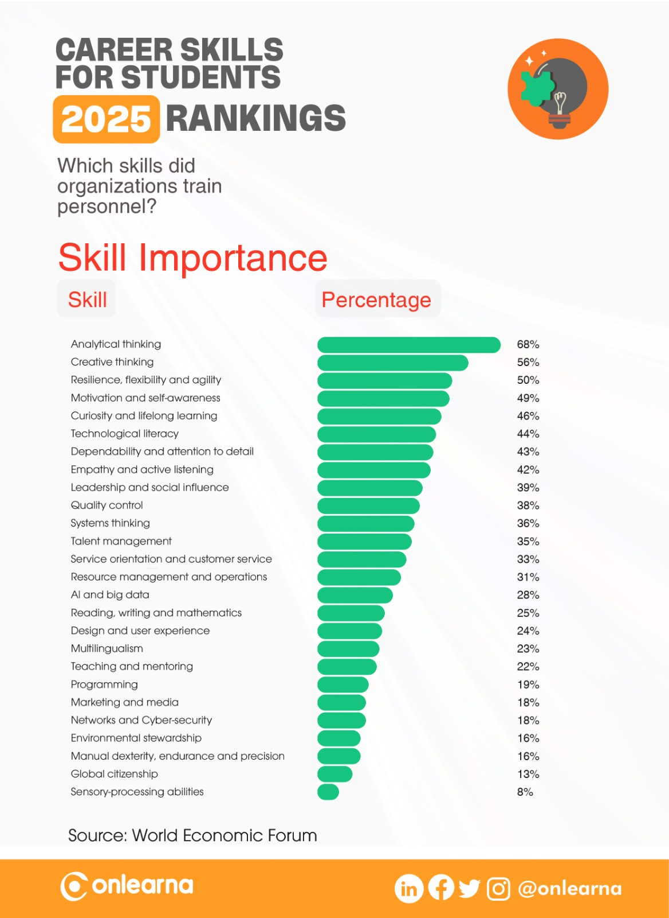

Slide 11
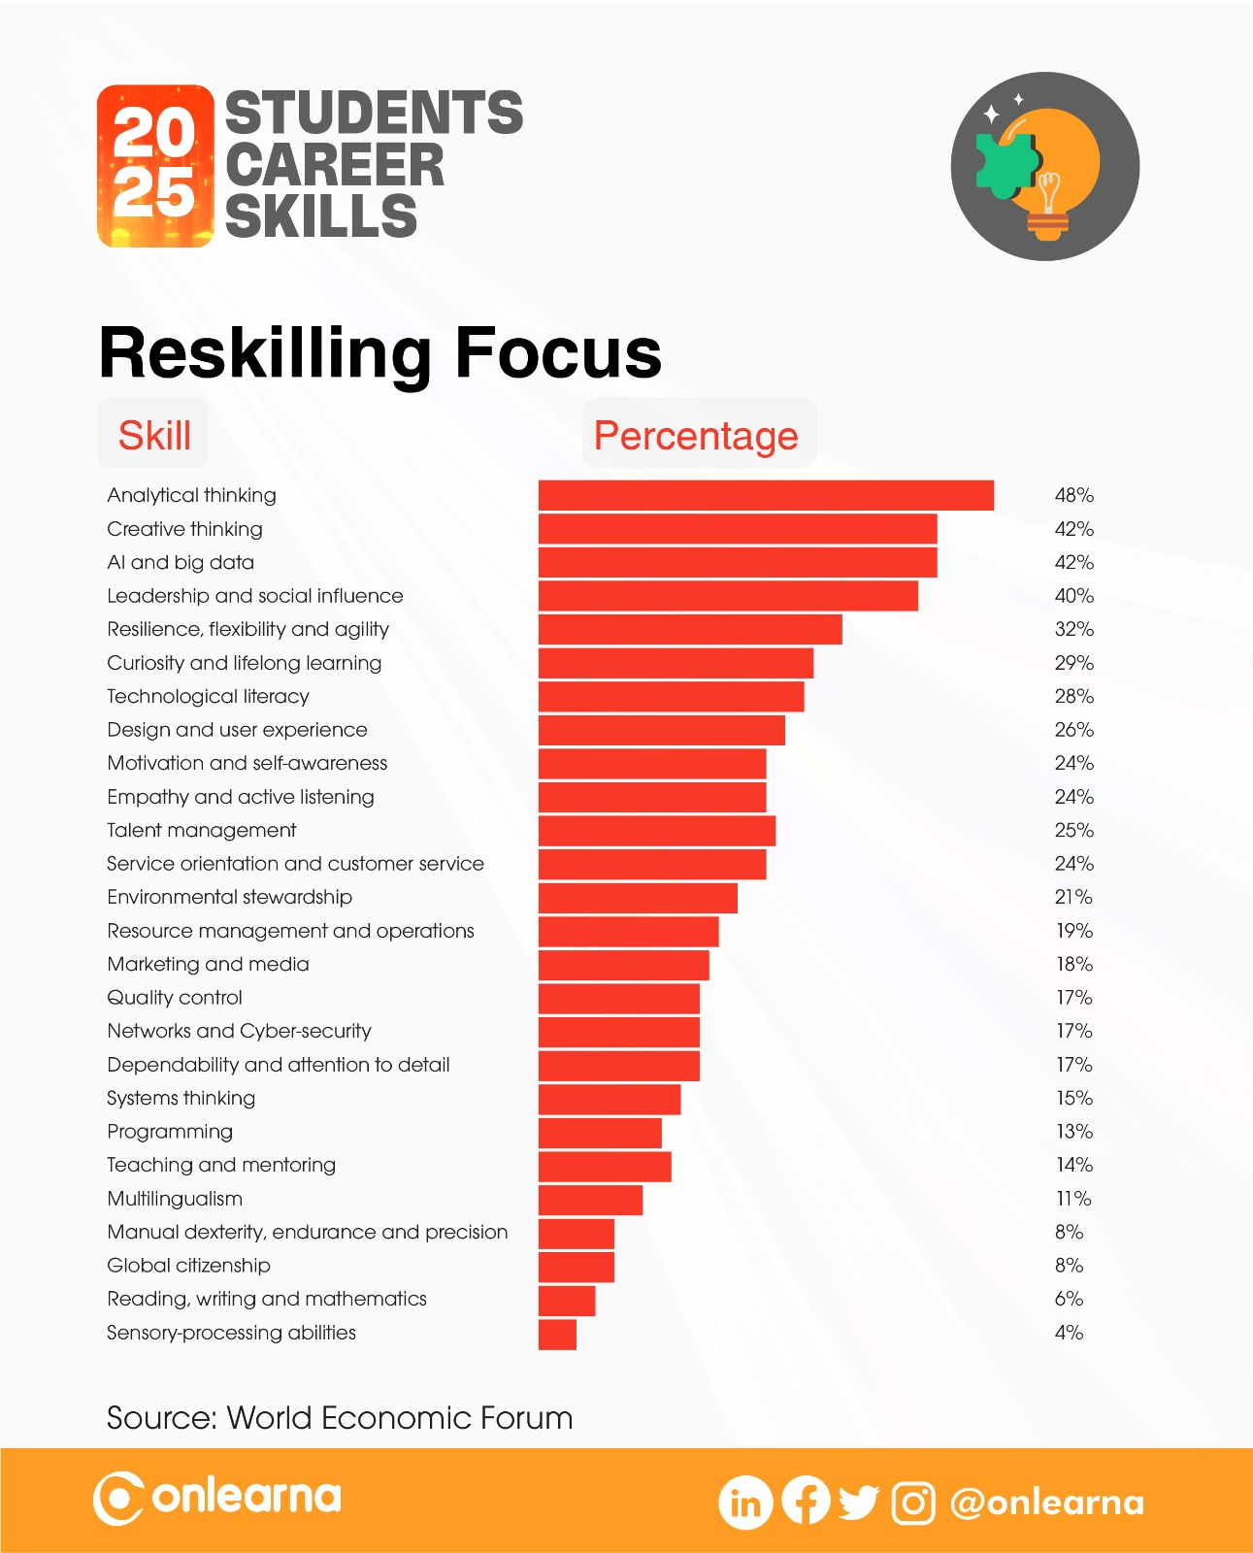

Slide 12
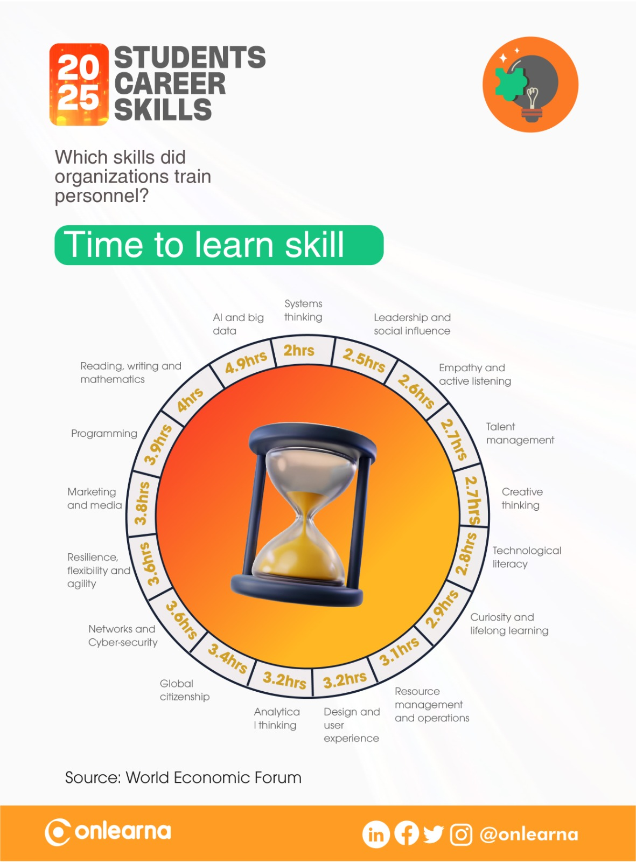

Slide 13
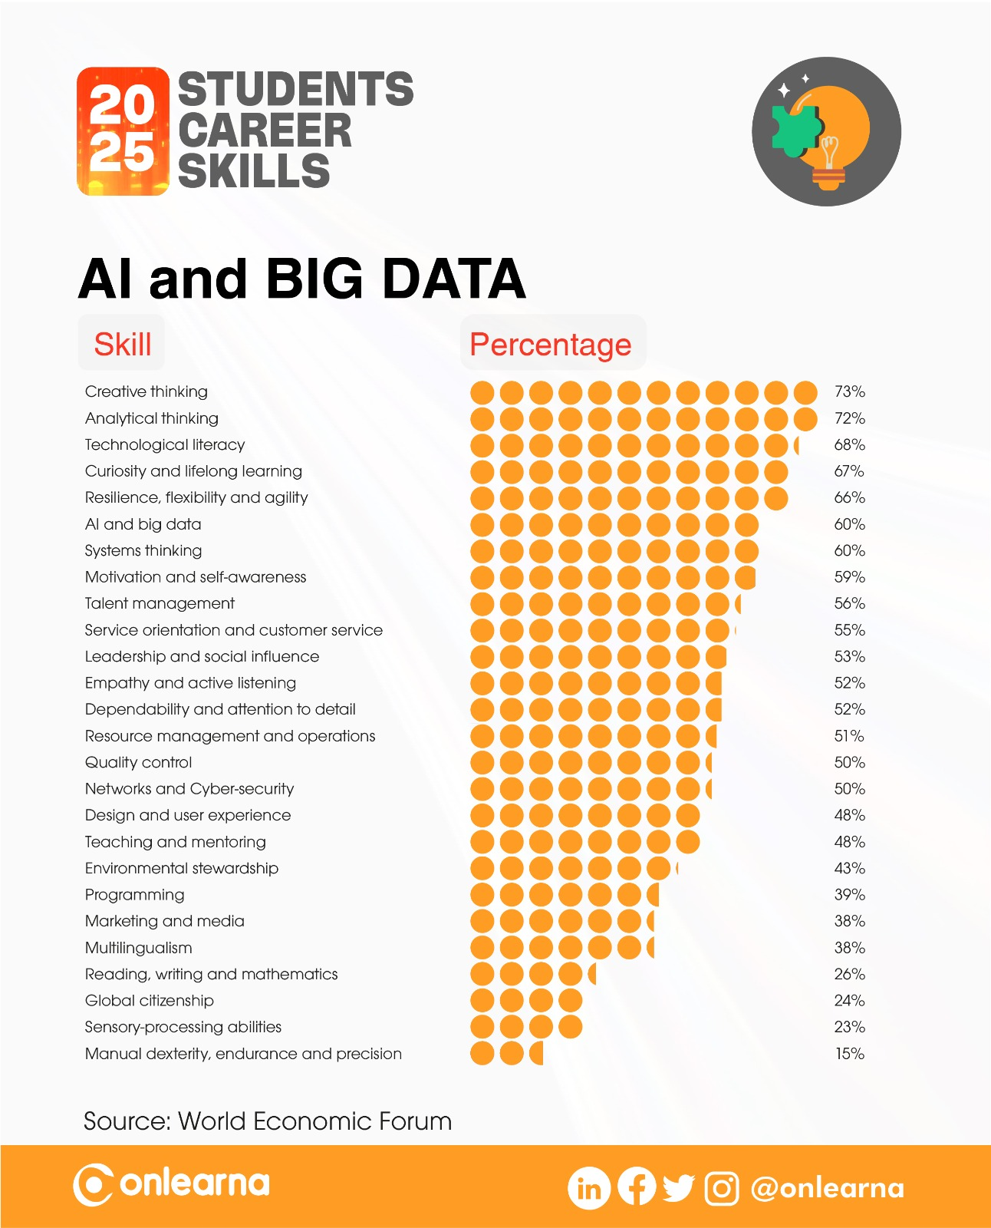

Slide 14
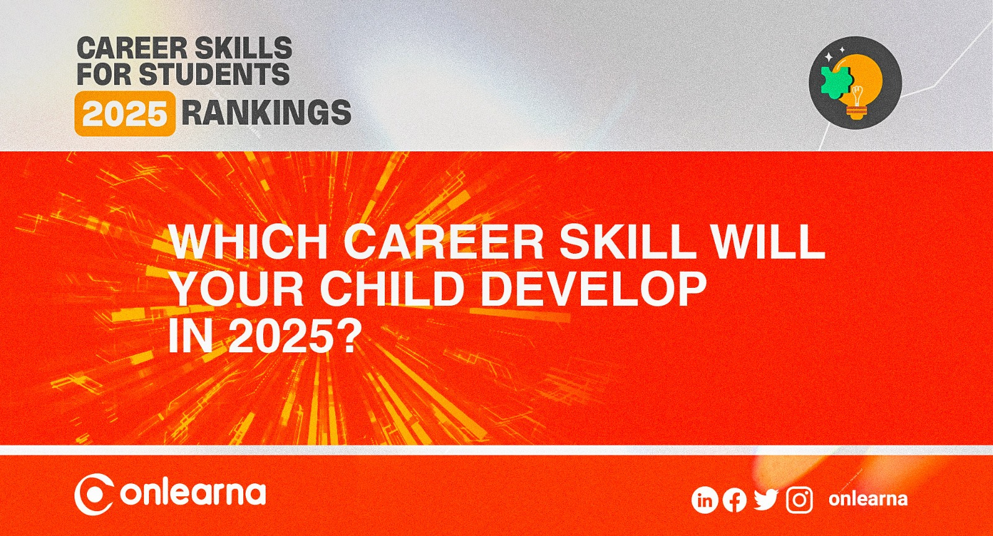

Slide 15
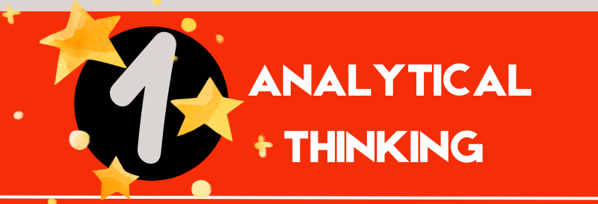

Slide 16
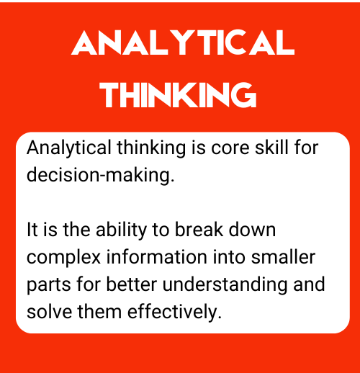
What is Analytical Thinking skill?

Slide 17
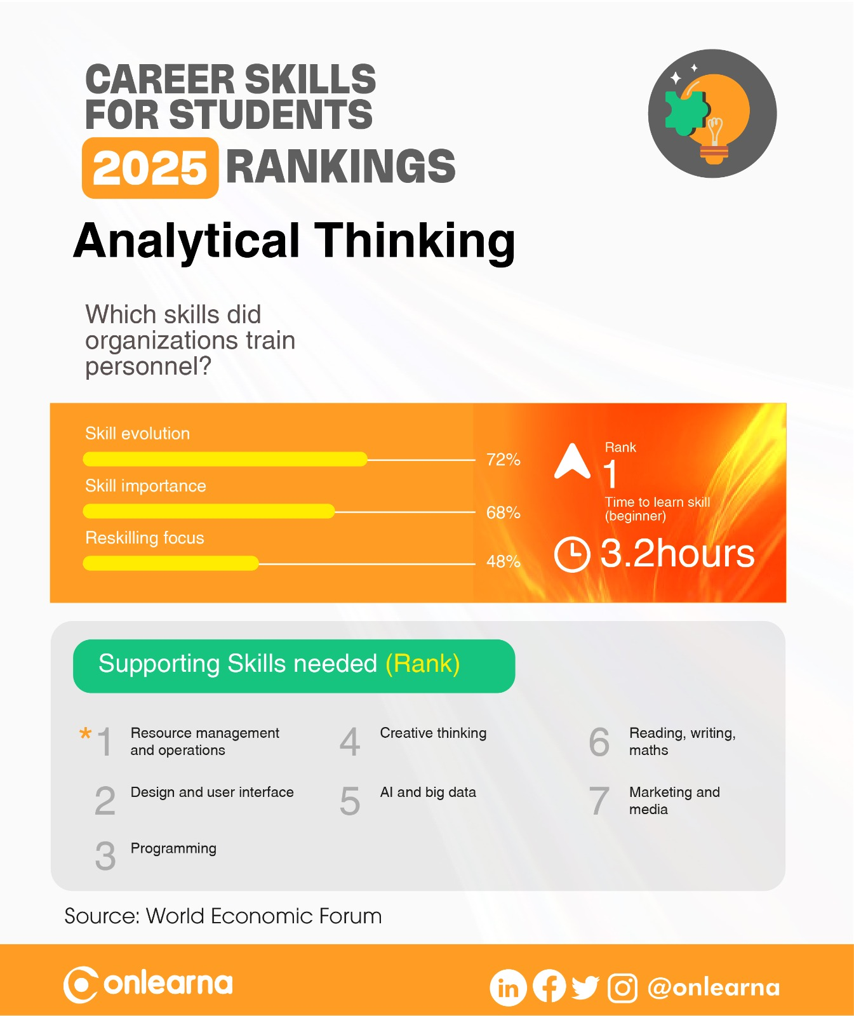

Slide 18
ANALYTICAL THINKING
What does your child like about this career skill?
What your child doesn’t like about this career skill?

Slide 19
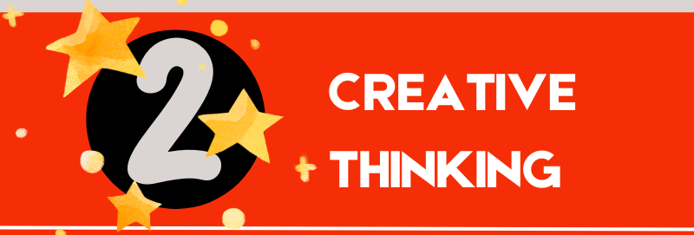

Slide 20
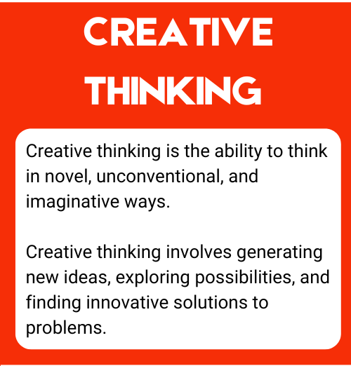
What is Creative Thinking skill?

Slide 21
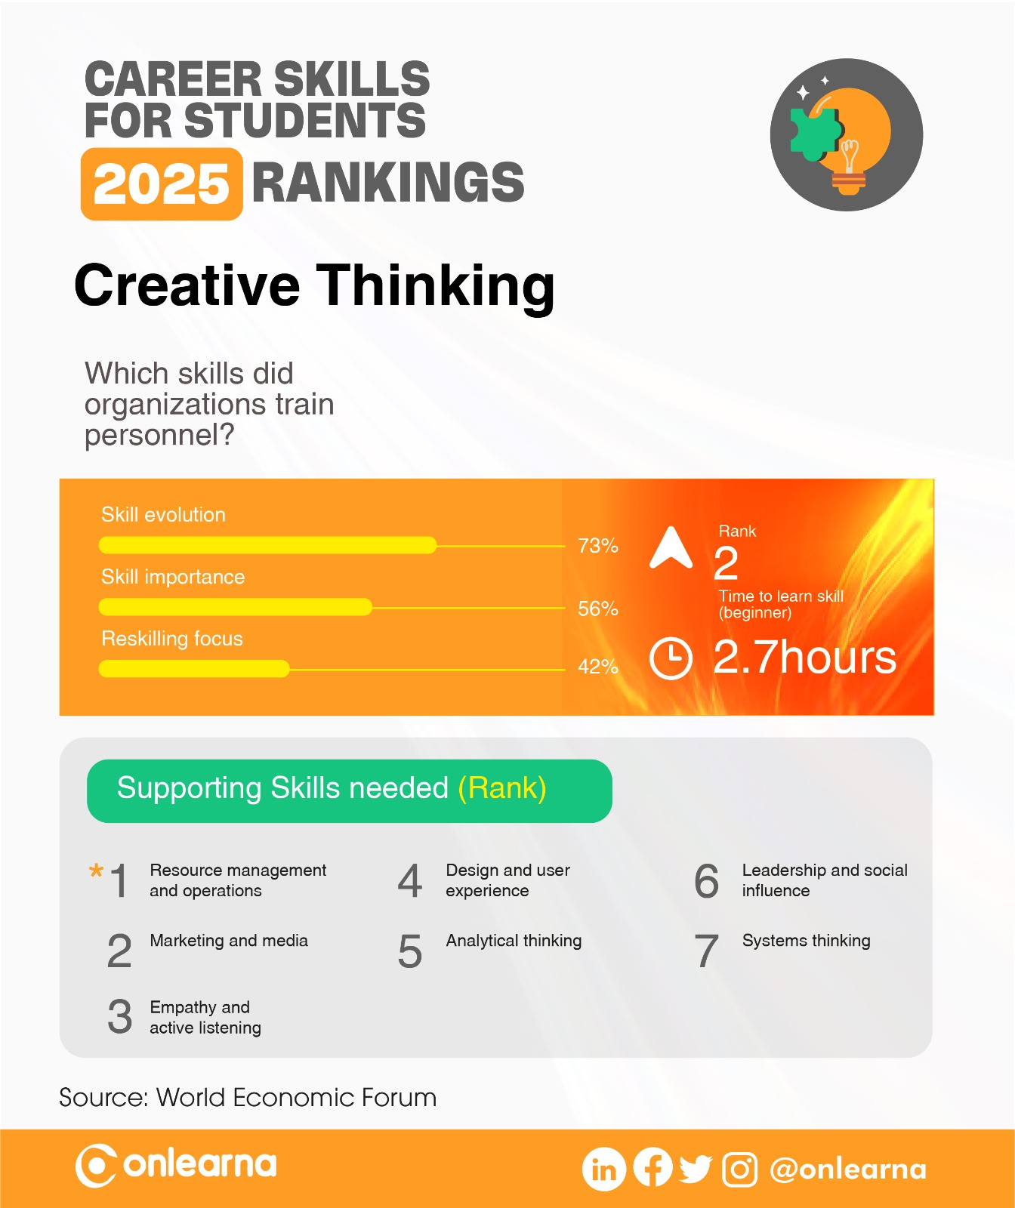

Slide 22
CREATIVE THINKING
What does your child like about this career skill?
What your child doesn’t like about this career skill?

Slide 23
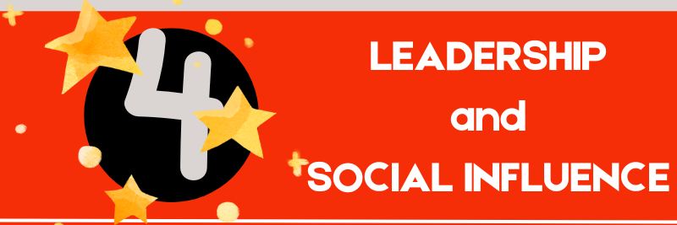

Slide 24
What is Leadership & Social Influence skill?

Slide 25
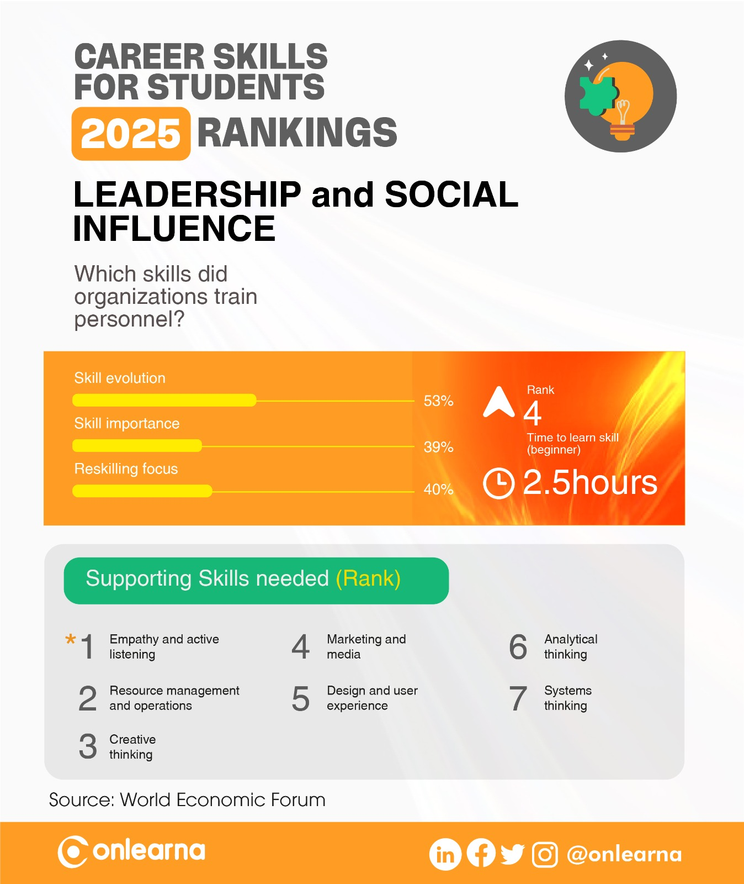

Slide 26
LEADERSHIP & SOCIAL INFLUENCE
What does your child like about this career skill?
What your child doesn’t like about this career skill?

Slide 27


Slide 28
What is Resilience, Flexibility and Agility?

Slide 29


Slide 30
RESILIENCE, FLEXIBILITY & AGILITY
What does your child like about this career skill?
What your child doesn’t like about this career skill?

Slide 31


Slide 32
What is Curiosity & Lifelong Learning skill?

Slide 33


Slide 34
CURIOSITY and LIFELONG LEARNING
What does your child like about this career skill?
What your child doesn’t like about this career skill?

Slide 35
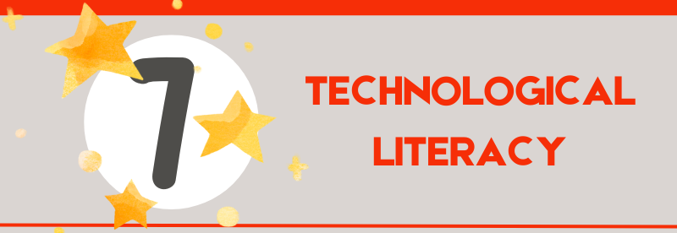

Slide 36
What is Tech Literacy skill?

Slide 37
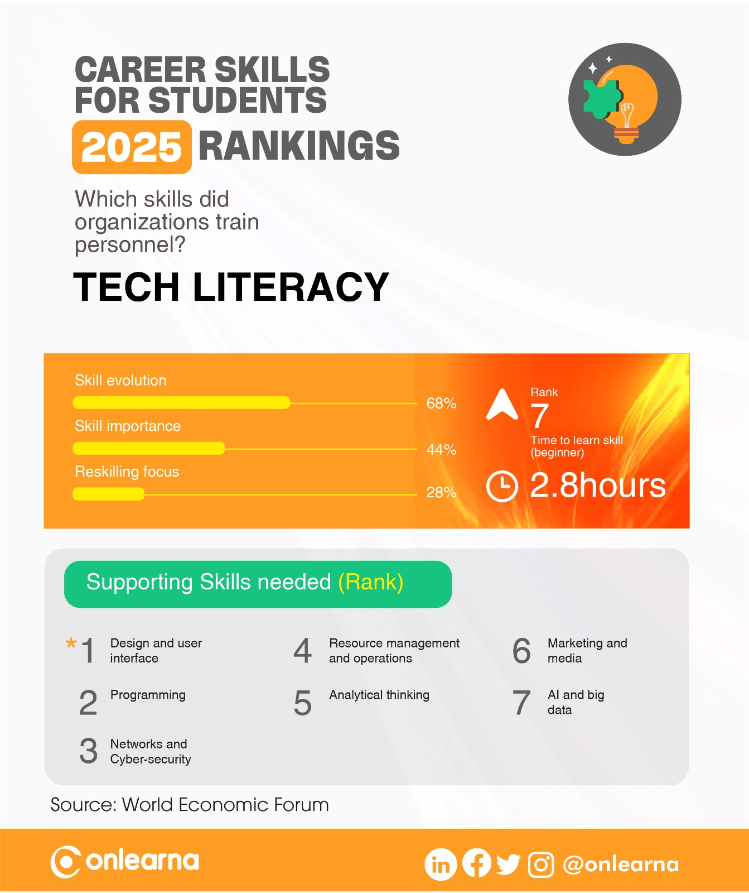

Slide 38
TECH LITERACY
What does your child like about this career skill?
What your child doesn’t like about this career skill?

Slide 39
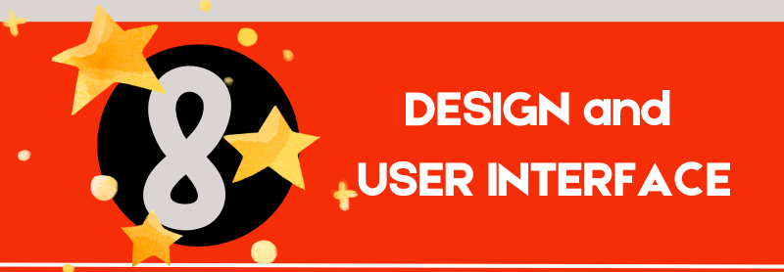

Slide 40
What is Design & User Literacy skill?

Slide 41
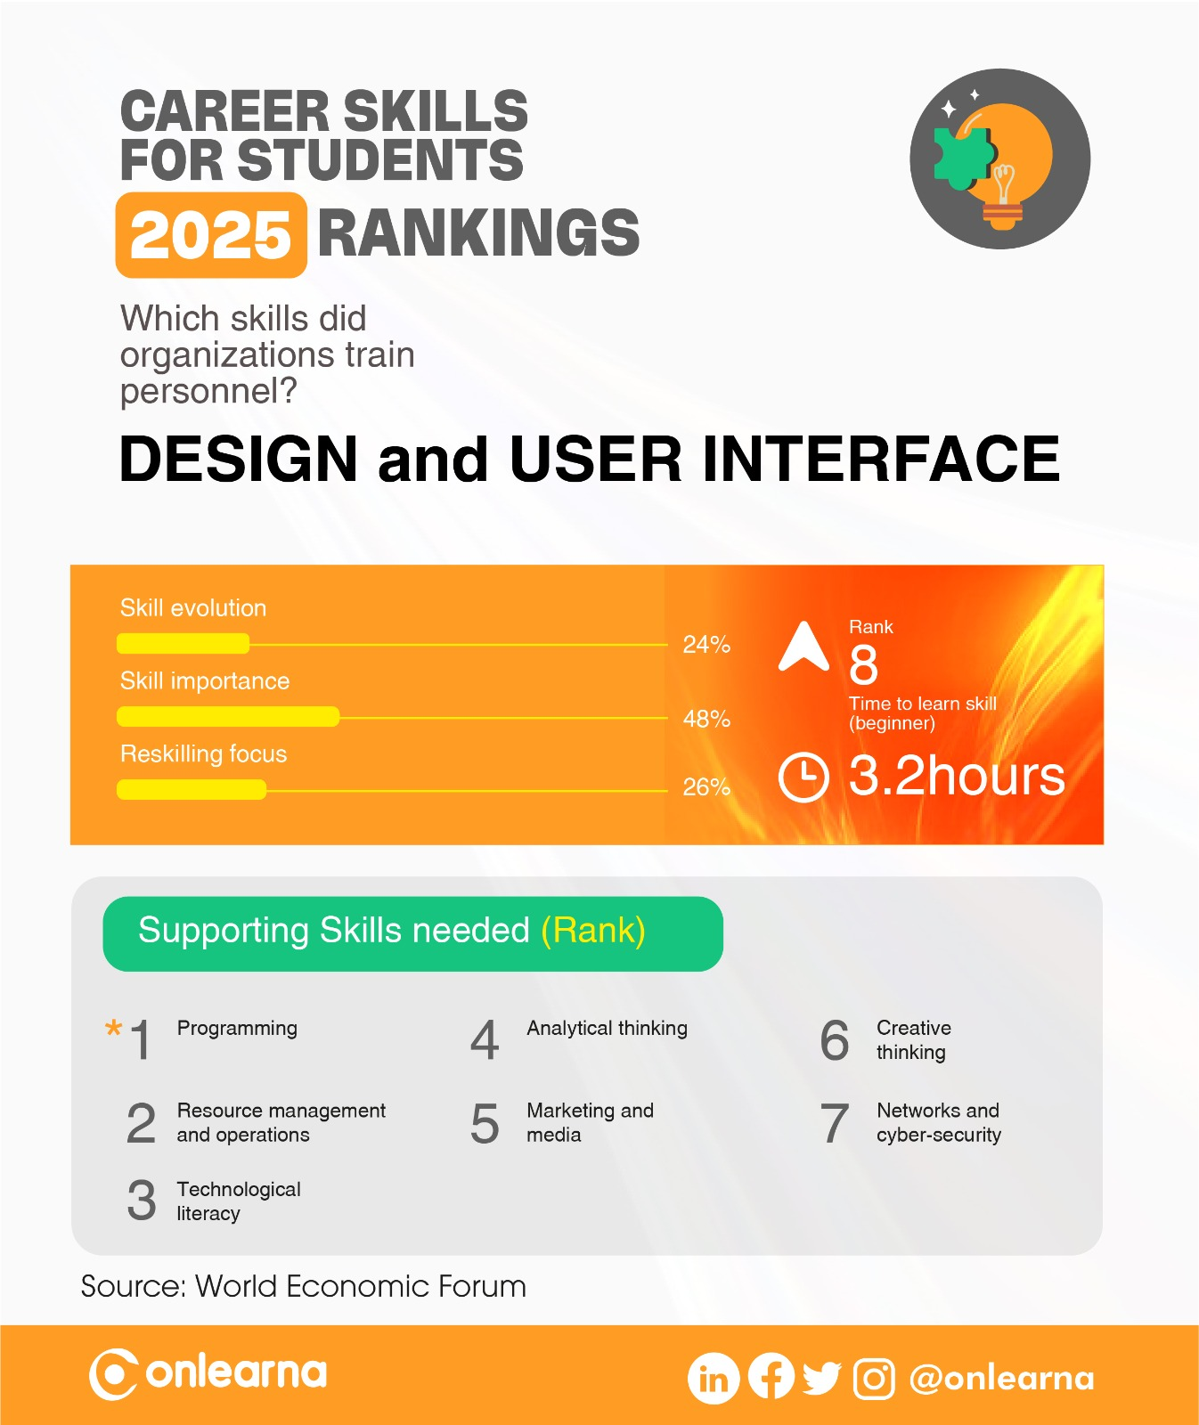

Slide 42
DESIGN & USER INTERFACE
What does your child like about this career skill?
What your child doesn’t like about this career skill?

Slide 43


Slide 44
What is Motivation and Self-awareness?

Slide 45
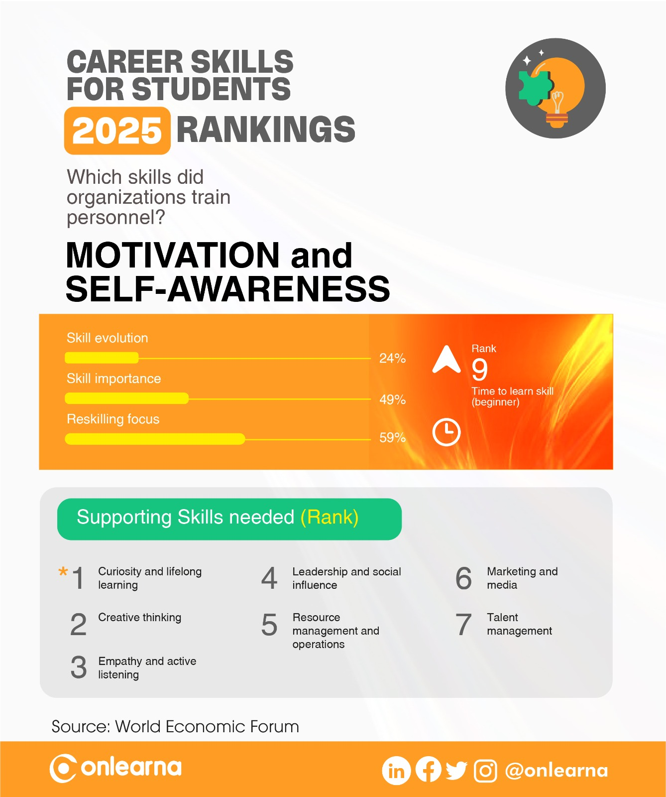

Slide 46
MOTIVATION & SELF-AWARENESS
What does your child like about this career skill?
What your child doesn’t like about this career skill?

Slide 47
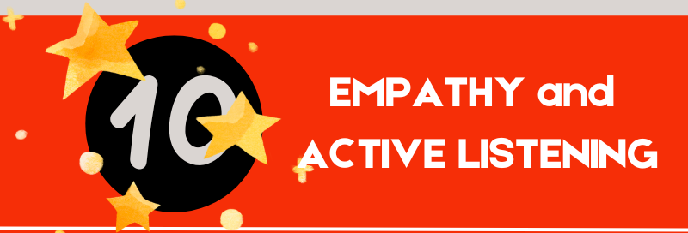

Slide 48
What is Empathy & Active Listening?

Slide 49
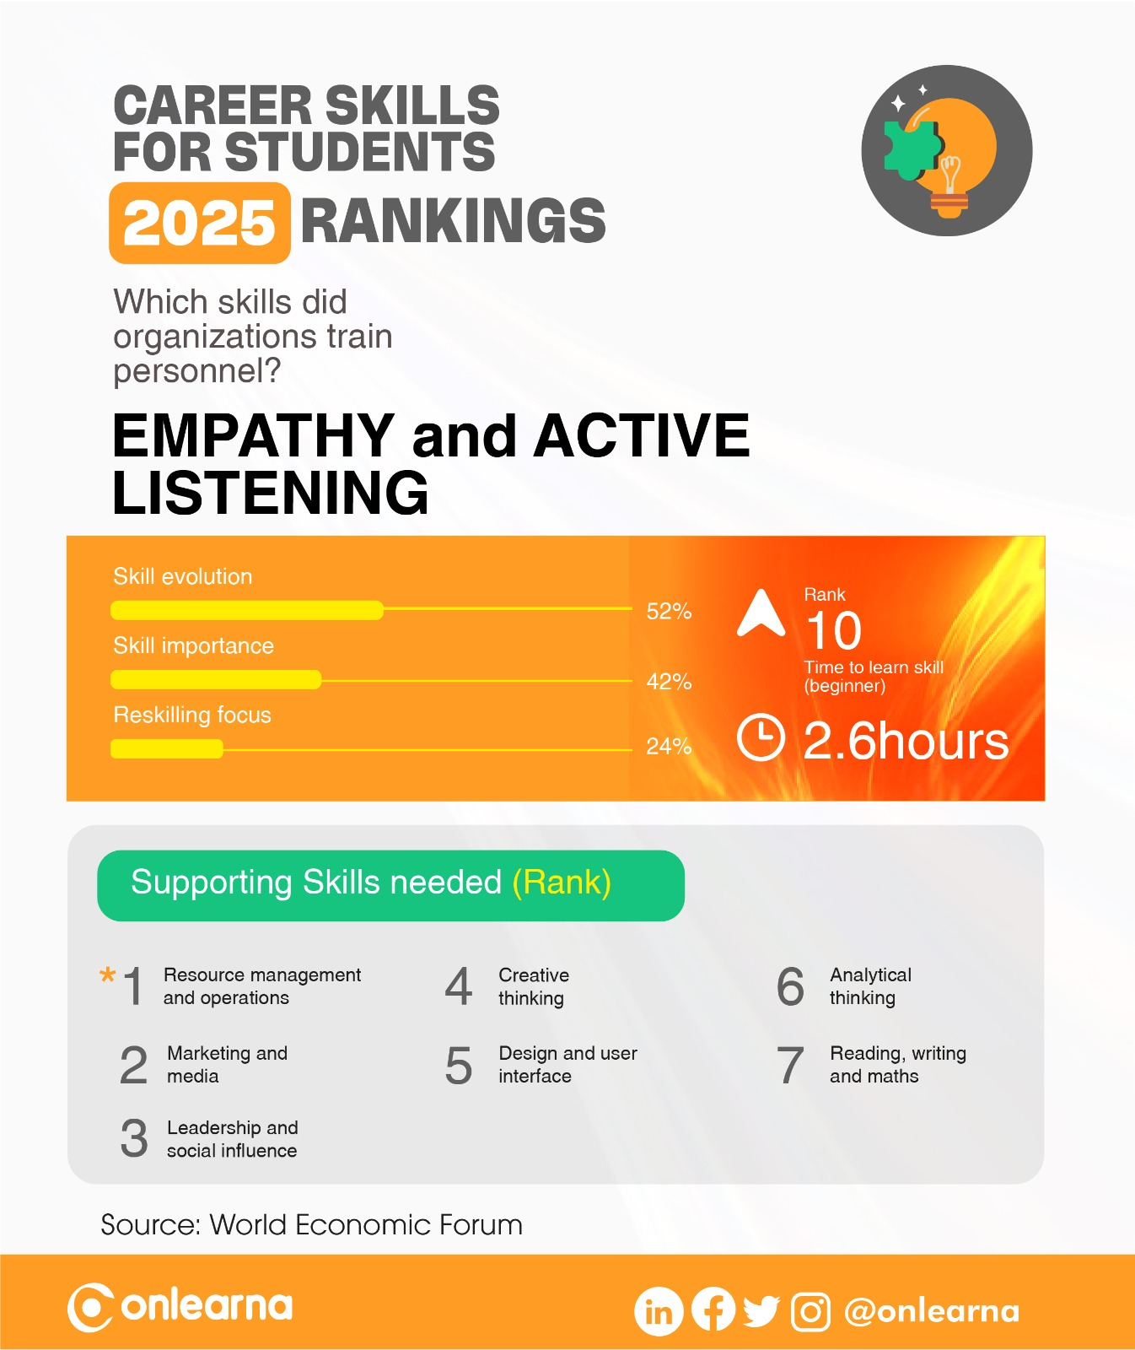

Slide 50
EMPATHY & ACTIVE LISTENING
What does your child like about this career skill?
What your child doesn’t like about this career skill?

Slide 51
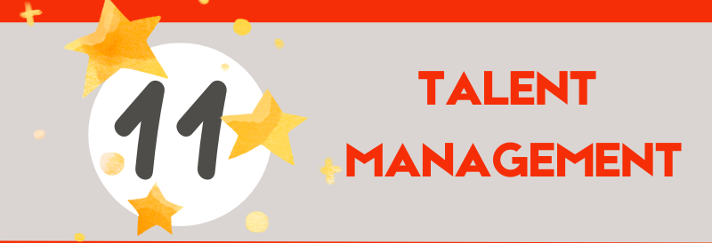

Slide 52
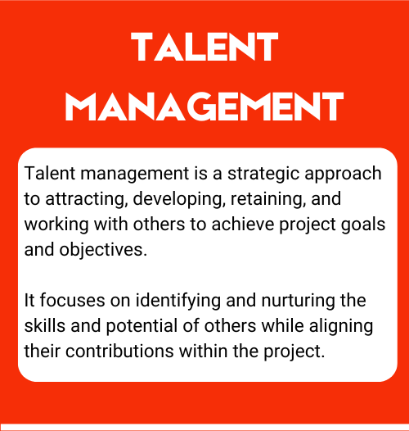
What is Talent Management?

Slide 53
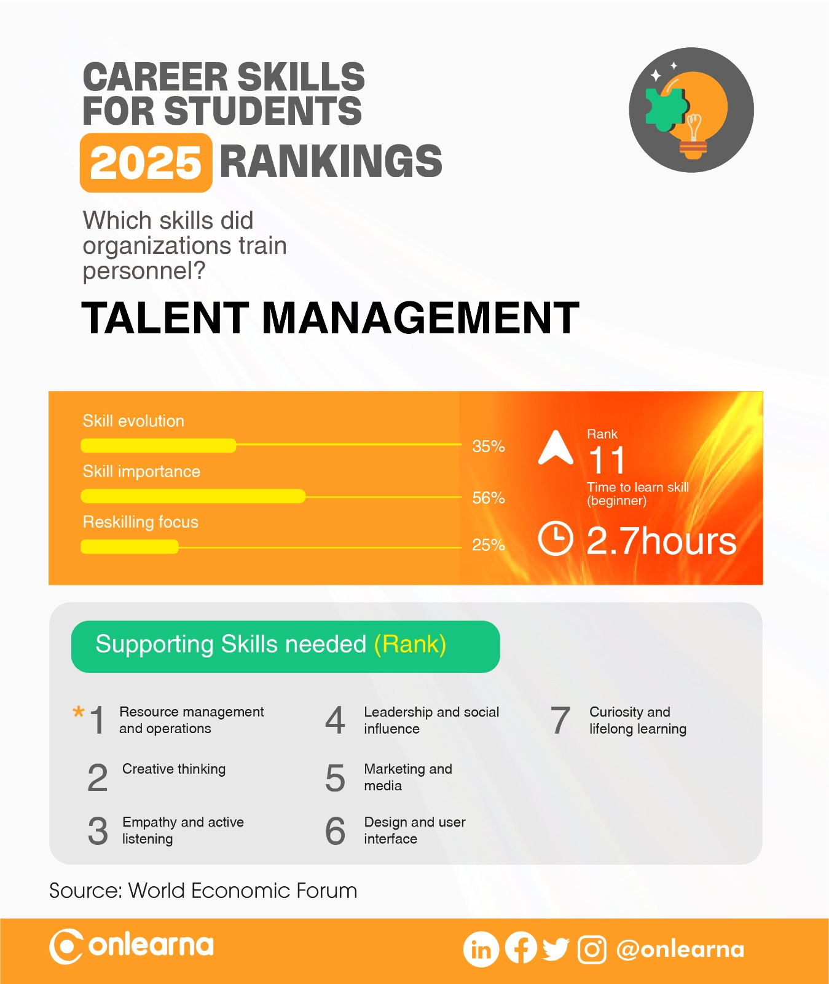

Slide 54
TALENT MANAGEMENT
What does your child like about this career skill?
What your child doesn’t like about this career skill?

Slide 55
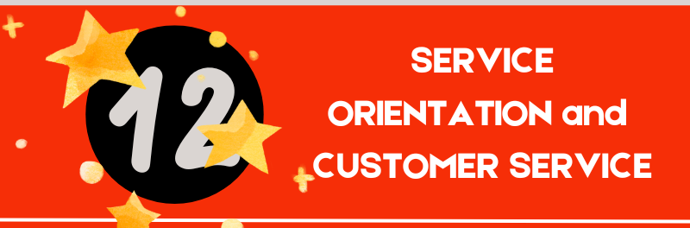

Slide 56
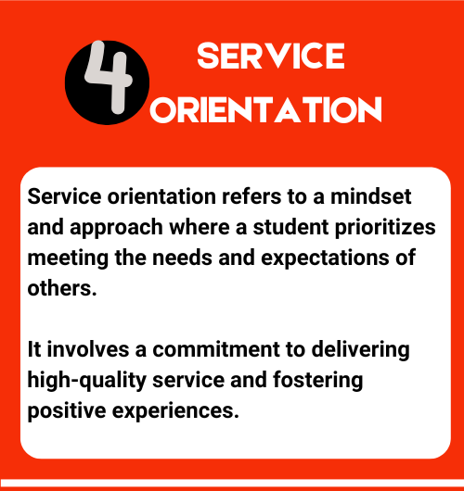
What is Service Orientation and Customer Service?

Slide 57
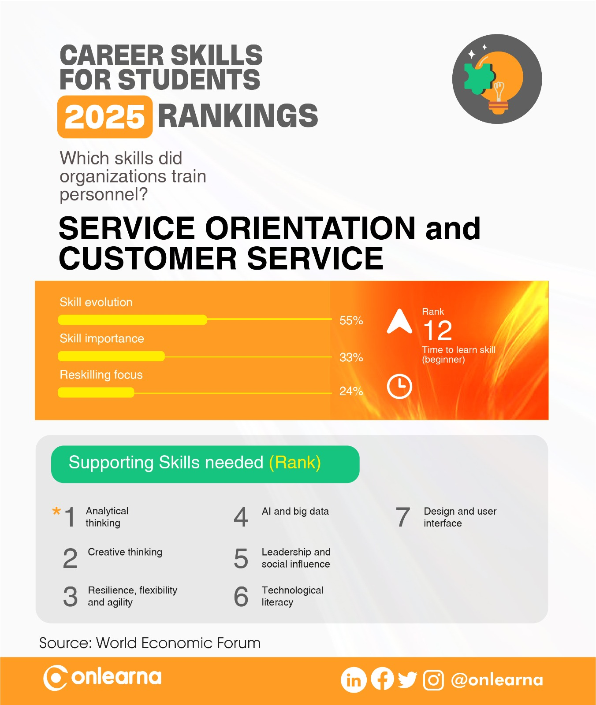

Slide 58
SERVICE ORIENTATION and CUSTOMER SERVICE
What does your child like about this career skill?
What your child doesn’t like about this career skill?

Slide 59
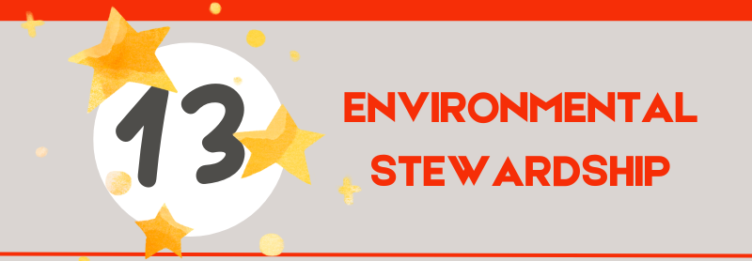

Slide 60
What is Environmental Stewardship?

Slide 61
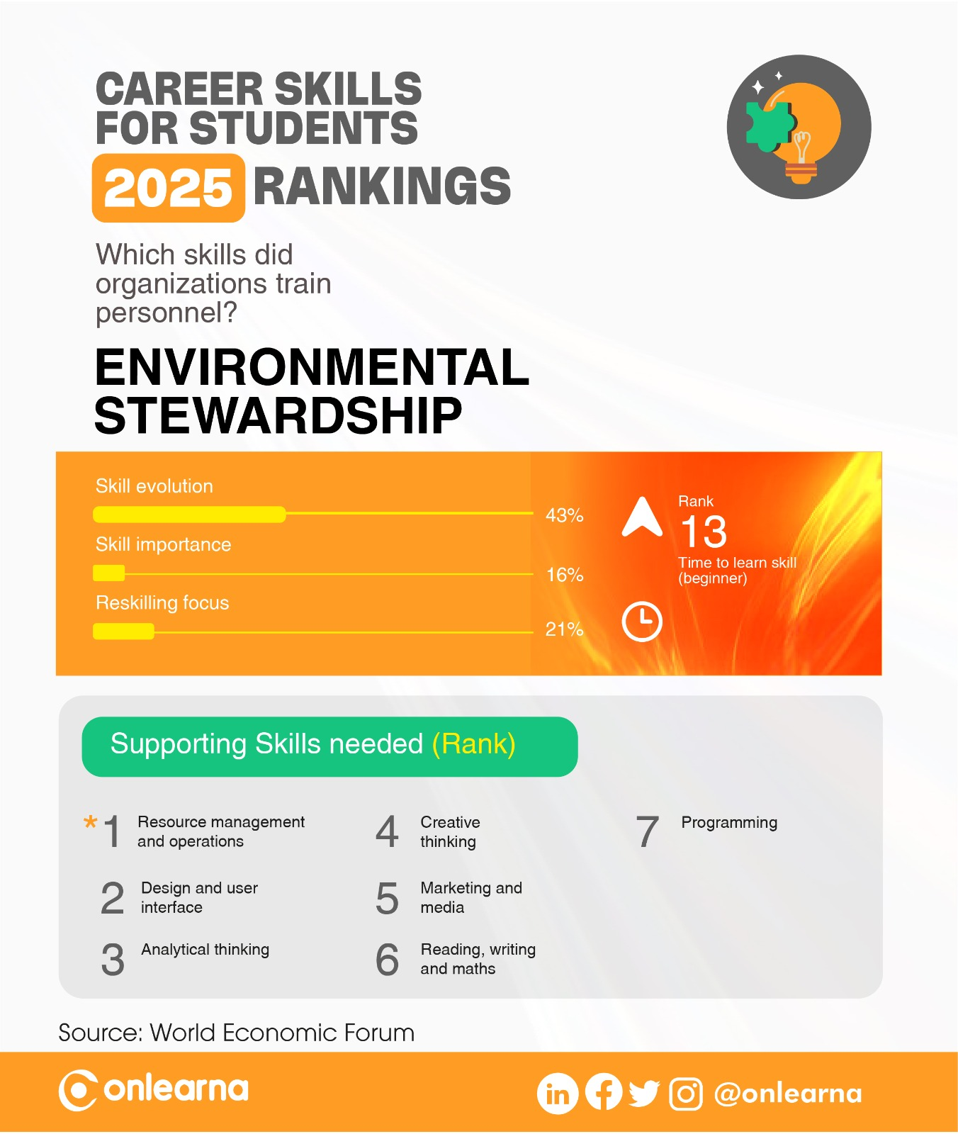

Slide 62
ENVIRONMENTAL STEWARDSHIP
What does your child like about this career skill?
What your child doesn’t like about this career skill?

Slide 63
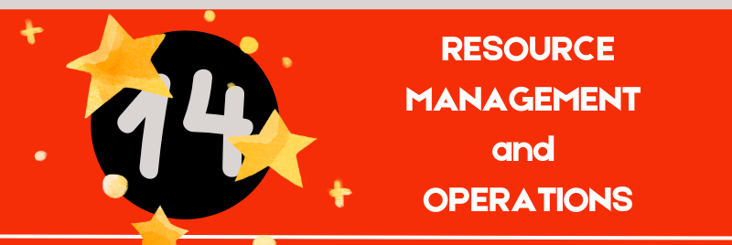

Slide 64
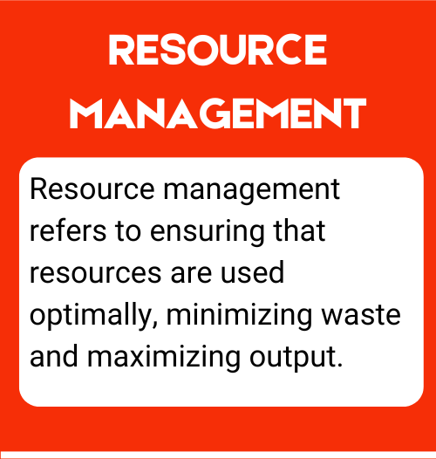
What is Resource Management and Operations?

Slide 65


Slide 66
RESOURCE MANAGEMENT & OPERATIONS
What does your child like about this career skill?
What your child doesn’t like about this career skill?

Slide 67
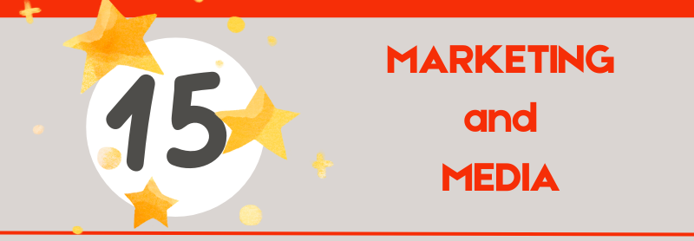

Slide 68
What is Marketing and Media?

Slide 69
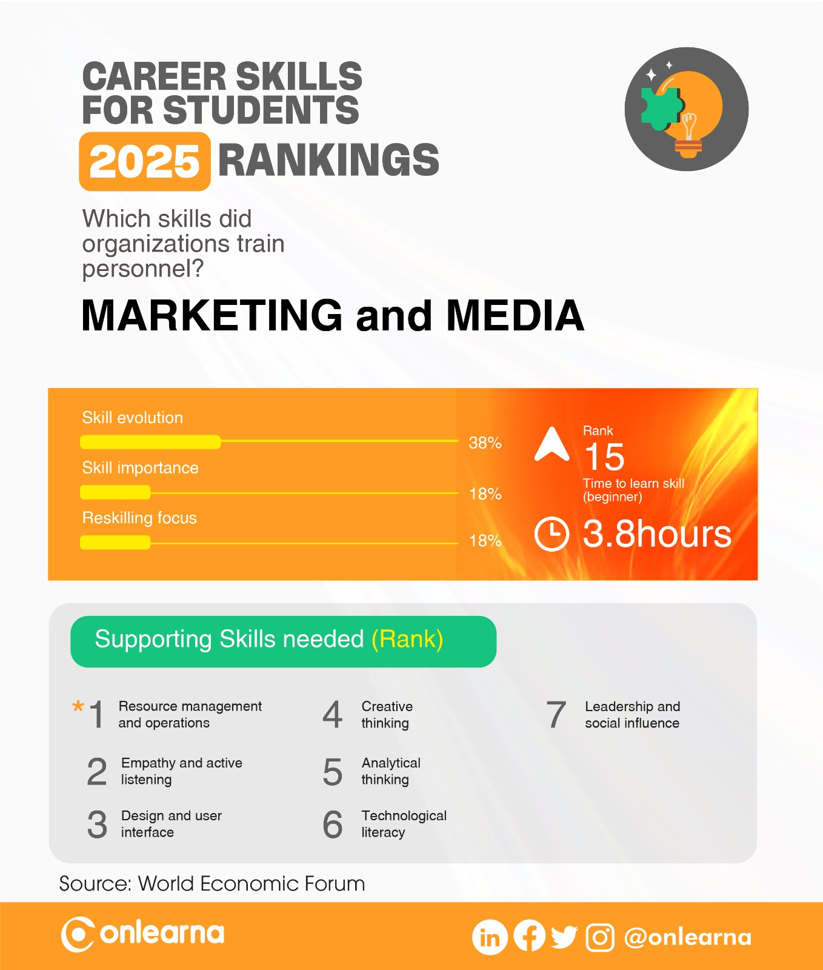

Slide 70
MARKETING & MEDIA
What does your child like about this career skill?
What your child doesn’t like about this career skill?

Slide 71


Slide 72

What is Networks & Cybersecurity?

Slide 73
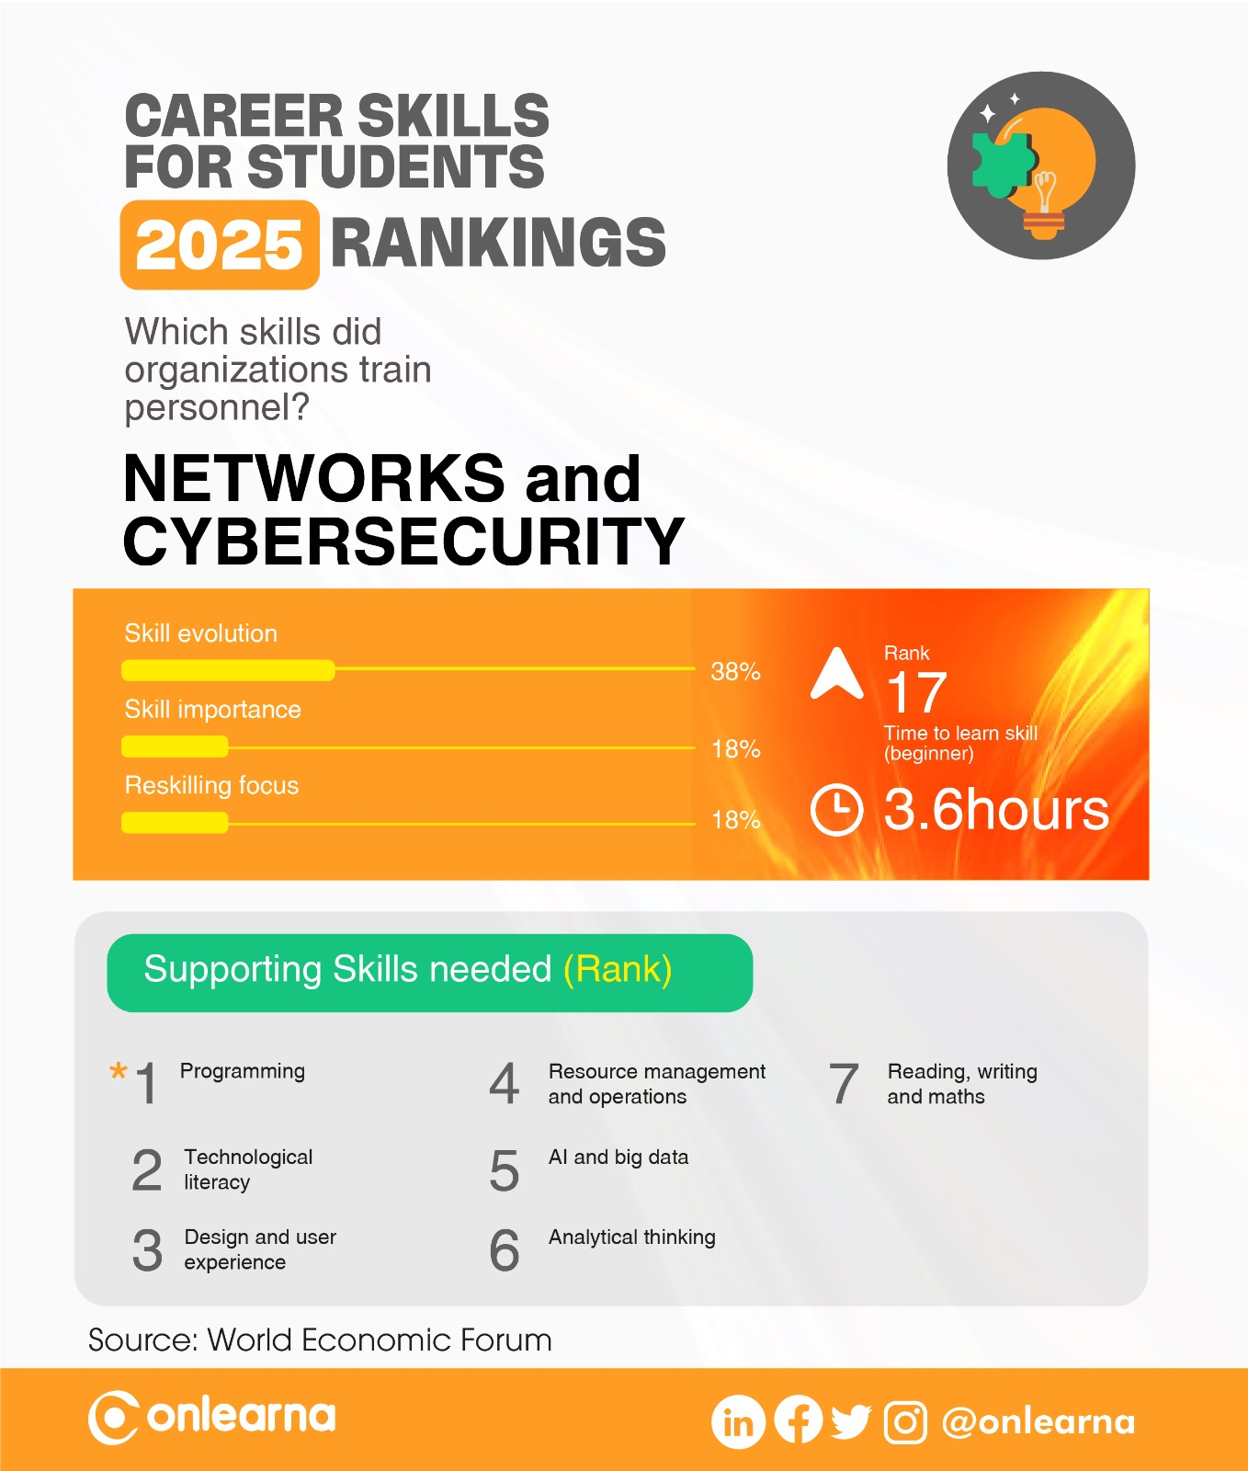

Slide 74
NETWORKS & CYBERSECURITY
What does your child like about this career skill?
What your child doesn’t like about this career skill?

Slide 75
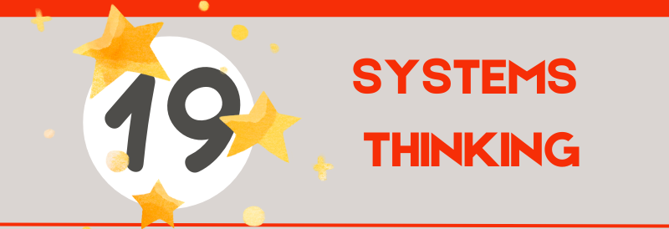

Slide 76
What is Systems Thinking?

Slide 77
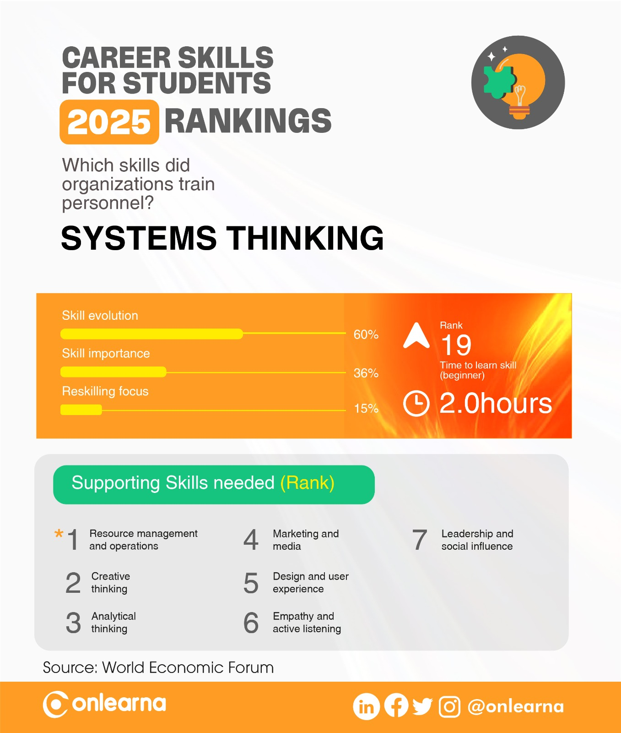

Slide 78
SYSTEMS THINKING
What does your child like about this career skill?
What your child doesn’t like about this career skill?

Slide 79
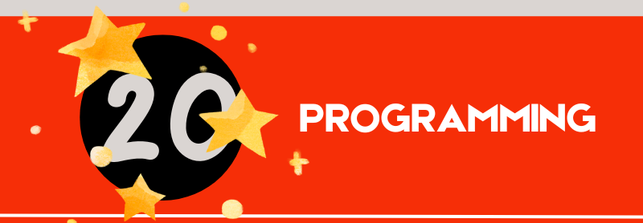

Slide 80
What is Programming?

Slide 81
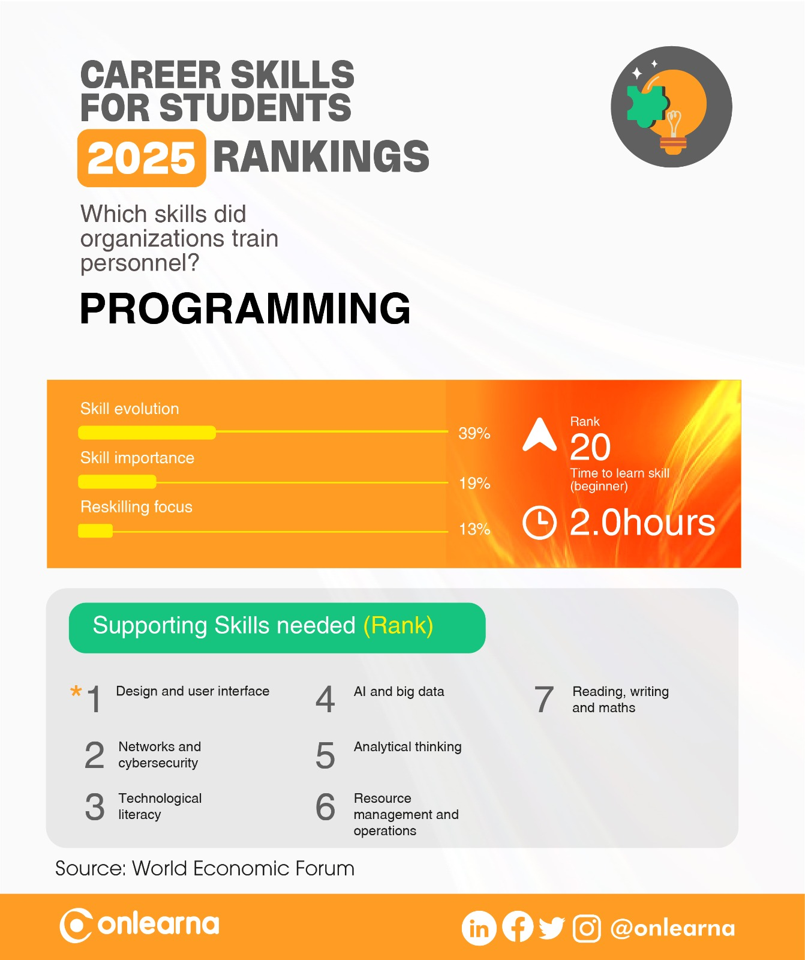

Slide 82
PROGRAMMING
What does your child like about this career skill?
What your child doesn’t like about this career skill?

Slide 83
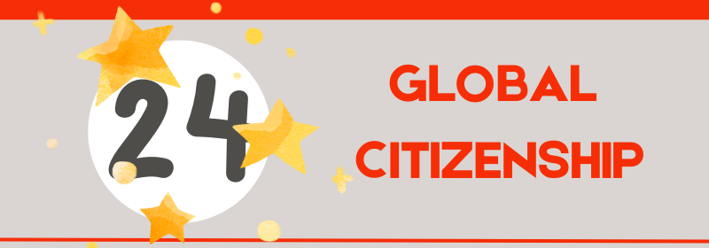

Slide 84
What is Global Citizenship?

Slide 85


Slide 86
GLOBAL CITIZENSHIP
What does your child like about this career skill?
What your child doesn’t like about this career skill?

Slide 87


Slide 88
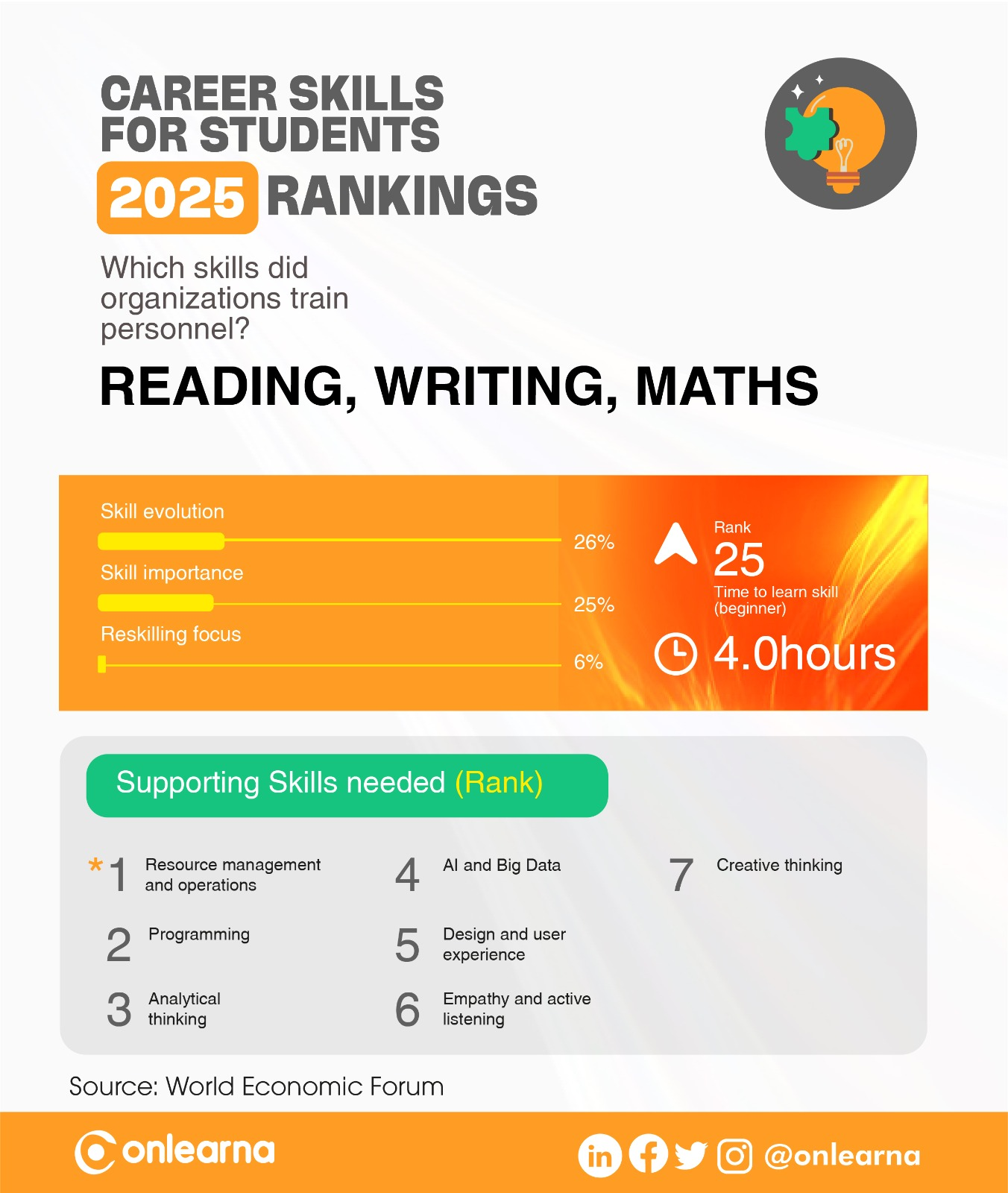

Slide 89
READING, WRITING & MATHS
What does your child like about this career skill?
What your child doesn’t like about this career skill?

